Slide 1
Nonlinear Dimensionality Reduction for Hyperspectral Image Classification
Tim Doster
Advisors:
John Benedetto & Wojciech Czaja

Slide 2
High Dimensional Data
Data that contains many readings for each object
Examples include:
Medical
Identification and Biometrics
Polling and Questionnaires
Imaging: Hyperspectral Images

Slide 3
Hyperspectral Imagery
A black and white digital image contains 1 spectral band
A numerical value represents intensity
For example an integer between 0 and 255
A color digital image contains 3 spectral bands
Red, blue and green
A Hyperspectral digital image contains hundreds of spectral bands
Visible, infrared, ultraviolet

Slide 4
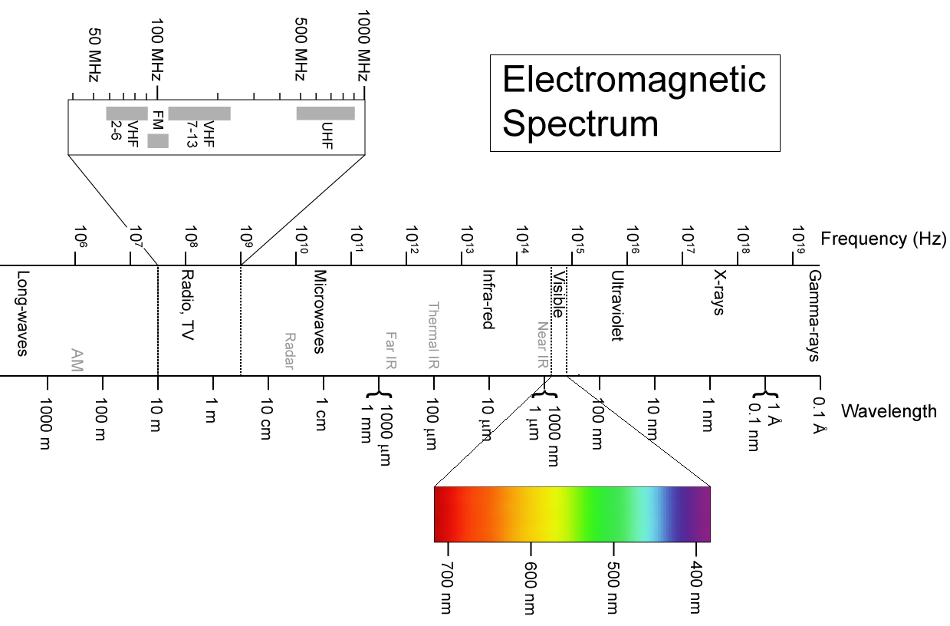
Hyperspectral Imagery

Slide 5
Hyperspectral Imagery
Sensor takes readings one line at a time for all bands - push broom
May have to fly multiple swaths to complete one image
Data is corrected for errors and false readings caused by vibrations and atmospheric scattering

Slide 6
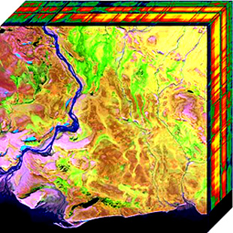
Hyperspectral Imagery
Hyperspectral Cube
Each pixel has an associated vector of sensor readings for specific wavelengths
Typical Images are at least 1000x1000 pixels with 150 bands
150 million data points
~300 megabytes

Slide 7
Advantages/Disadvantages
More data = better chance for discovery
Materials show vastly different properties in different wavelengths
Proven in areas of agriculture, mineralogy, and surveillance
Storage cost
Transmission cost
Analysis cost
Too much information for human processing
Must rely on computer algorithms to process images

Slide 8
Dimensionality Reduction
Due to volume of data, to make analyzing, transmission, and storage easier, we seek to reduce to dimensionality of the data without sacrificing too much of the intrinsic structure of the data
We also seek to make differences between pixels more dramatic by throwing away similar information

Slide 9
Techniques For Dimensionality Reduction
Linear
PCA
Simple to implement and run, shown to perform worse on complex high dimensional data sets
Nonlinear
Local Linear Embedding
Kernel PCA
Many, many more …
Does not require manifold to be defined by linear vectors, but requires much more processing
Notes:
PCA preserves as much variation as possible
LLE local distance
Kernel PCA global distance

Slide 10
Basic Method Behind Non-Linear Dimensionality Reduction
0. Start with a data set X in R^{D}
1. Suppose the data lies on some unknown manifold with dimensionality d << D
2. Build an adjacency graph using nearest neighbors for each data point that approximates this unknown manifold
3. Solve an eigenproblem to minimize the difference in the distances between neighbors in R^{D} and R^{d}

Slide 11
Local Linear Embedding
Step 1: Find the KNN for each point in the data set using the Euclidean metric.
Step 2: Find the linear combination (reconstruction weights), W_{i}, for each pixel from its KNN.
We are creating a hyperplane through each point which is invariant to rotation, translation and stretching
The W_{i}‘s form a matrix W called the weight matrix

Slide 12
Local Linear Embedding
Step 3. We minimize the cost function:
to compute the lower dimensional embedding. It can be shown that this is equivalent to finding the the eigenvectors associated with the d smallest nonzero eigenvalues to:
M=(I-W)^{T}(I-W)

Slide 13
Local Linear Embedding

Slide 14
Kernel PCA
So as not to bore you Kernel PCA is similar to LLE
The major difference is that among the k-nearest neighbors for x those that are closer to x are given a higher weight in the reconstruction

Slide 15
Computation Costs
For Example LLE is:
KNN: O(N log N)
Finding Weights: O(N D K³)
Solving Eigenproblem: O(dN²)
Since N is the number of pixels in the image these calculations can become daunting

Slide 16
Out of Sample Extensions or Landmarks
The basic idea is build the neighborhood graph with a small subset of the available points and then find the minimum eigenvectors.
Those points not chosen as landmarks use the embeddings of their k-nearest landmarks to define their embedding.
We sacrifice embedding accuracy for vastly improved speed and storage

Slide 17
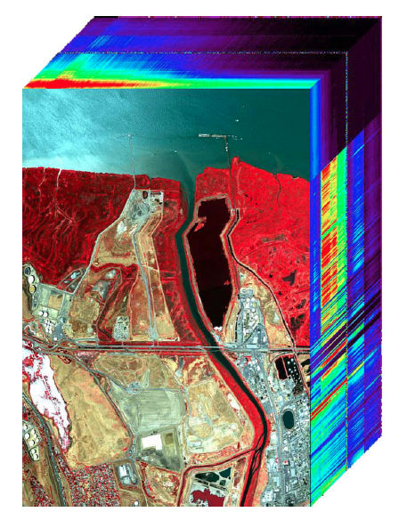
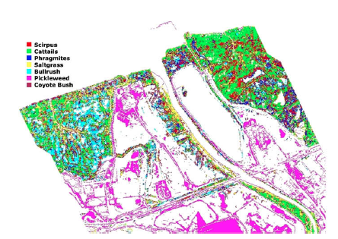
Example Data Set Land Classification
PROBE1 HSI Image
Ground Classification
Notes:
Probe1 Sensor -

Slide 18
Software and Libraries
IDL/ENVI
Loading and classification of images
Matlab
Prototyping
Dimensionality Reduction Toolbox (Matlab)
Testing and validation
C++
LLE and Kernel PCA with landmark algorithms

Slide 19
Software and Libraries
BLAS and LAPACK (C++)
Linear algebra and eigensolvers
ANN: Approximate Nearest Neighbor Searching (C++)
Finds the approximate or exact nearest neighbors for a graph

Slide 20
Software Flow

Slide 21
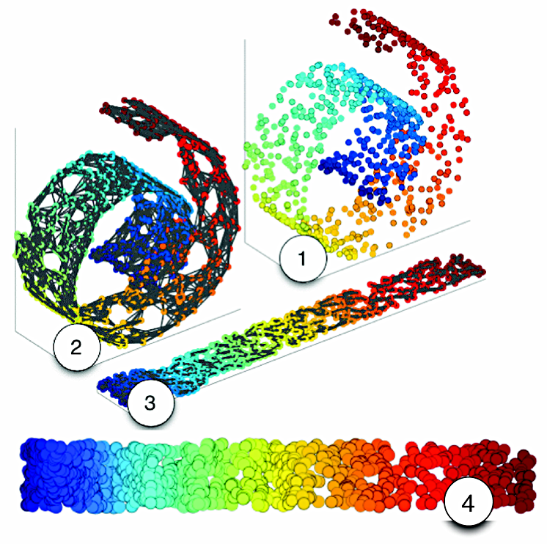
Validation
Make use of artificial data sets, used in manifold learning, which are defined in 3 dimensions but actually lie on a 2 dimensional manifold

Slide 22
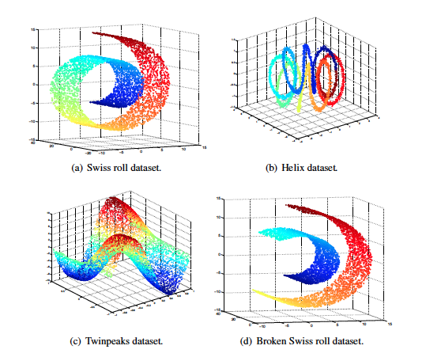
Validation

Slide 23
Validation - Tests
Notes:
1-neighbor trustworthiness and continuity evaluate to what extent the local structure of the data is retained

Slide 24
Timeline
Sep & Oct – Read literature, prototype algorithms, and write proposal document
Oct & Nov - Implement LLE and Kernel PCA in C++ and validate algorithms
Dec – Prepare midterm presentation
Jan – Link C++ code with IDL/ENVI
Feb & March – Implement landmarks and validate algorithms
April – Use algorithms with and without landmarks on hyperspectral classification image
May – Prepare final presentation
If time permits: parallel implementation, other NLDR algorithms, automatic KNN selection

Slide 25
References
An Introduction to Local Linear Embedding
Saul and Roweis, 2001
Kernel Principle Component Analysis
Scholkopf, Smola and Muller, 2004
Out-of-Sample Extensions for LLE, Isomap, MDS, Eigenmaps, and Spectral Clustering
Bengio, Paiement and Vincent, 2003
A Weighted Kernel PCA Formulation with Out of Sample Extension
Alzate, 2006
Exploting Manifold Geometry in Hyperspectral Imagery
Bachmann, Ainsworth and Fusina, 2005
Dimensionality Reducation: A Comparitive Review
Maaten, Postma and Herik, 2008
ANN: A Library for Approximate Nearest Neighbor Searching
Mount and Arya, 2010

Slide 26
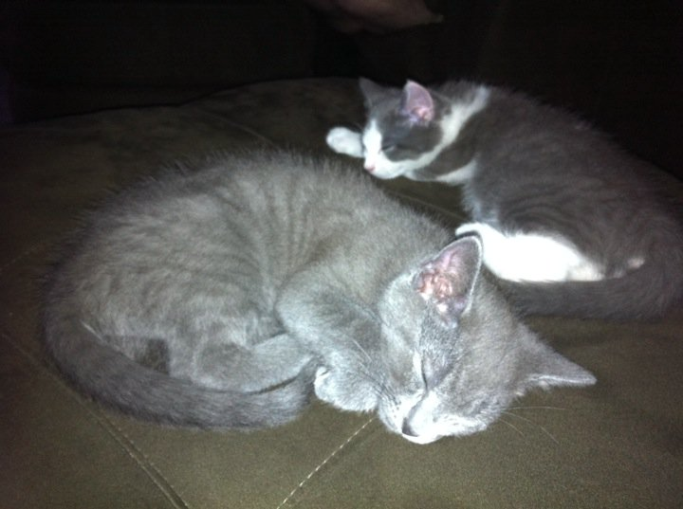
Any Questions?
If you have no questions here is picture of my new kittens Barely and Hops to entertain you

