Slide 1
Nonlinear Dimensionality Reduction for Hyperspectral Image Classification
Tim Doster
Advisors:
John Benedetto & Wojciech Czaja

Slide 2
Outline
Introduction
Dimensionality Reduction
Algorithms
Implementation
Challenges
Validation
Next Semester

Slide 3
High Dimensional Data
Data that contains many readings for each object
Examples include:
Medical
Identification and Biometrics
Polling and Questionnaires
Imaging: Hyperspectral Images

Slide 4
Hyperspectral Imagery
A black and white digital image contains 1 spectral band
A numerical value represents intensity
For example an integer between 0 and 255
A color digital image contains 3 spectral bands
Red, blue and green
A Hyperspectral digital image contains hundreds of spectral bands
Visible, infrared, ultraviolet

Slide 5
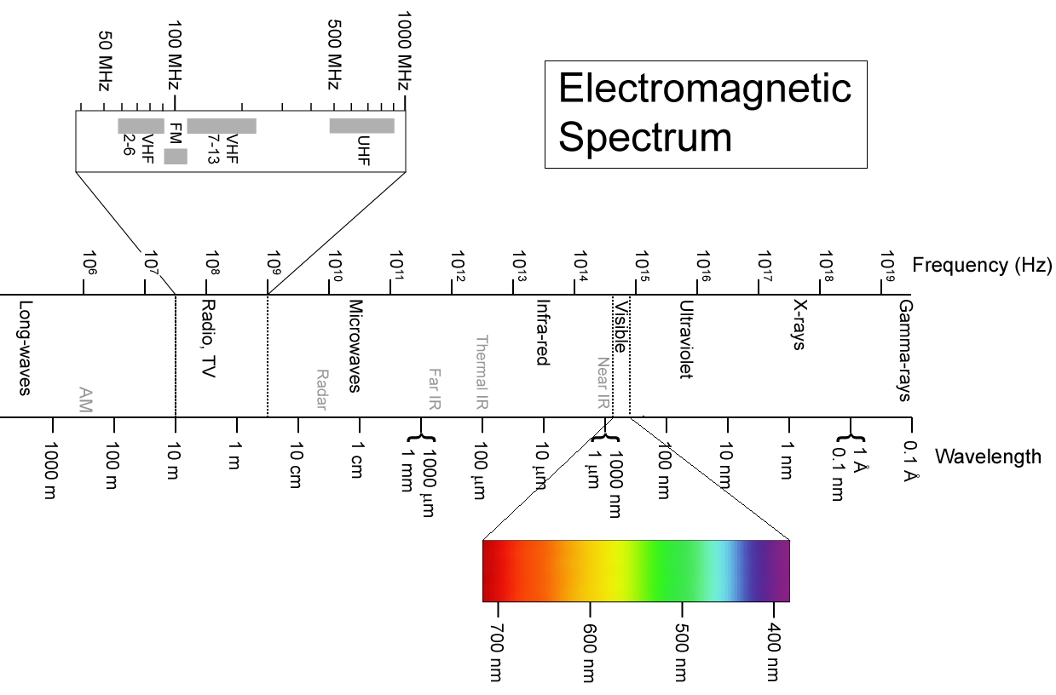
Hyperspectral Imagery

Slide 6
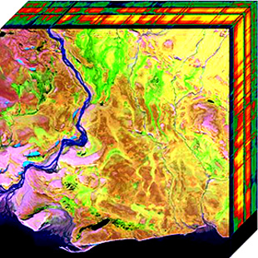
Hyperspectral Imagery
Hyperspectral Cube
Each pixel has an associated vector of sensor readings for specific wavelengths
Typical Images are at least 1000x1000 pixels with 150 bands
150 million data points
~300 megabytes

Slide 7
Dimensionality Reduction
Due to volume of data, to make analysis, transmission, and storage easier, we seek to reduce to dimensionality of the data without sacrificing too much of the intrinsic structure of the data
We also seek to make differences between pixels more dramatic by throwing away similar information

Slide 8
Techniques For Dimensionality Reduction Used
Local Linear Embedding
ISOMAP

Slide 9
Local Linear Embedding
Step 1: Find the KNN for each point in the data set using the Euclidean metric.
Step 2: Find the linear combination (reconstruction weights), W_{i}, for each pixel from its KNN.
We are creating a hyperplane through each point which is invariant to rotation, translation and stretching
The W_{i}‘s form a matrix W called the weight matrix

Slide 10
Local Linear Embedding
Step 3. We minimize the cost function:
to compute the lower dimensional embedding. It can be shown that this is equivalent to finding the the eigenvectors associated with the d smallest nonzero eigenvalues to:
M=(I-W)^{T}(I-W)
Notes:
Sparse – has k*p elements in p^2

Slide 11
Local Linear Embedding

Slide 12
ISOMAP
Step 1: Find the KNN for each point in the data set using the Euclidean metric.
Step 2: Calculate, S, the pairwise shortest geodesic distance for all data points
Step 3: Minimize the cost function,
where Y is the low dimension embedding

Slide 13
ISOMAP
Step 3 – Alternative
This minimization can be shown to be the same as finding
for the eigenproblem:
Note H is the centering matrix
Notes:
H=1/n 11
Matrix is general

Slide 14
Comparing the two
ISOMAP: preserve pairwise geodesic distance between points
LLE: preserve local properties only, e.g., relative local distances

Slide 15
Implementation
Initial prototyping in IDL and experimentation with Matlab DR Toolbox
LLE and ISOMAP were implemented in C++
Programs take as input the number of nearest neighbors (k), the intrinsic dimensionality (dim), and the data (data.in)
The programs return the embedding in a .out data file
Example
>>lle 3 2 data.in

Slide 16
Implementation
Made use of platform optimized libraries for matrix operations
Tried to use memory efficiently (still work in progress)
Calling destructor
Sparse matrices and solvers
Good cache management

Slide 17
Libraries Used
Boost Libraries
BLAS Level I,II,III calculations
Dot product, vector norm, matrix-vector product, matrix-matrix product, Ax=b
ARPACK
Sparse Eigenproblem solver
LAPACK
General Eigenproblem solver

Slide 18
Data files
Contain a header line with the number of rows, columns, and original dimensionality
When using actual images rows and columns are necessary to reform image
Values are comma separated for easy parsing in both C++ and Matlab

Slide 19
Program IO
data.in
1,8,3
1.1,2.2,3.4
3.1,2.2,4.1
1.5,1.7,1.6
2.2,2.2,4.5
2.2,4.4,4.9
1.1,0.2,0.5
0.5,0.5,0.5
3.2,2.5,5.9
data.out
1,8,2
-0.635175,-0.244168
0.396364,0.542725
-0.112297,-0.267642
-0.180249,0.171422
-0.279562,0.191863
0.414977,-0.395243
0.379083,-0.418873
0.0168588,0.419917

Slide 20
Profiling
bash-3.2$ ./lle 12 2 in.data 1
Data has been read in 0.000175 seconds
Pairwise distance matrix found 0.000101 seconds
k nearest neighbors found 8.2e-05 seconds
Reconstruction Weights found 0.012554
Output written to file 0.000221 seconds
Program Done
Runtime: 0.014169 seconds

Slide 21
Possible Optimizations
Better use of sparse matrices
Memory vs Processor program paths
Is it better to store some calculations that need to be used again or calculate them again and save memory?
Can likely be arrived at experimentally

Slide 22
Initial Validation Steps
Exactly match established Matlab output for small data set (10 points, 3 dimensions)

Slide 23
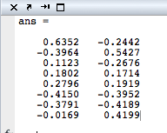
Initial Validation Step - LLE
C++ Implementation
Matlab DR Toolbox
-0.635175,-0.244168
0.396364,0.542725
-0.112297,-0.267642
-0.180249,0.171422
-0.279562,0.191863
0.414977,-0.395243
0.379083,-0.418873
0.0168588,0.419917

Slide 24
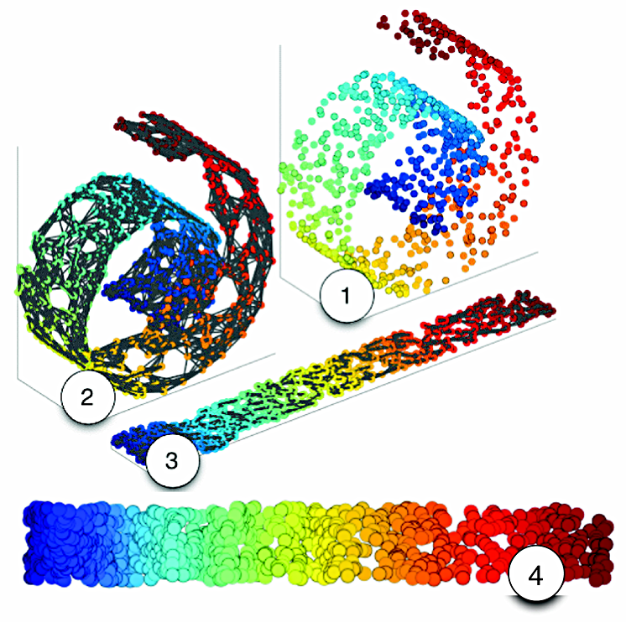
Validation
Make use of artificial data sets, used in manifold learning, which are defined in 3 dimensions but actually lie on a 2 dimensional manifold

Slide 25
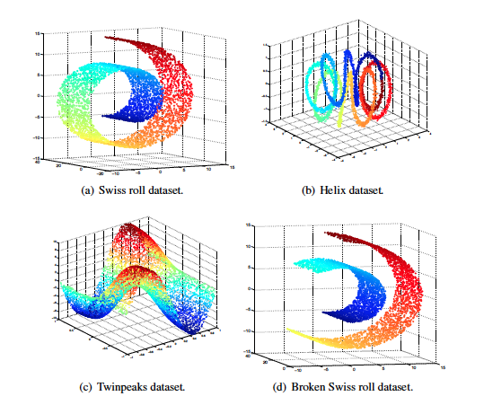
Validation

Slide 26
Validation - Tests
Notes:
1-neighbor trustworthiness and continuity evaluate to what extent the local structure of the data is retained

Slide 27
Validation Tests
Truthworthiness, T(k): Measures the proportion of points that are too close together
We want numbers close to 1
Continuity, C(k): Measures the proportion of points that are too far apart
We want numbers close to 1
Notes:
For Trustworthiness – how far away from the neighborhood are points in the low dimensional neighborhood coming form
For Continuity - how far away are points that in the low dimensional neighborhood from high dimensional neighborhood

Slide 28
Challenges Encountered
Using external libraries
Linking with program
different data structures
Sparsity
Matlab is really great at doing these things for you
Matching output to Matlab for large data sets
Eigensolvers all slightly different

Slide 29
What is next? Landmark Points
The basic idea is build the neighborhood graph with a small subset of the available points and then find the low dimensional embedding from these points.
Those points not chosen as landmarks use the embeddings of their k-nearest landmarks to define their embedding.
We sacrifice embedding accuracy for vastly improved speed and memory usage

Slide 30
Next Semester
January
Link C++ code with IDL/ENVI
Optimize code for memory usage
February and March
Implement landmarks and validate algorithms
April
Use algorithms with and without landmarks on hyperspectral classification images
May
Prepare final presentation
If time permits:
parallel implementation, other NLDR algorithms, automatic KNN selection

Slide 31
References
An Introduction to Local Linear Embedding
Saul and Roweis, 2001
A Global Network for Non-Linear Dimension Reducation
Teneenbaum, Silvia, Langford
Out-of-Sample Extensions for LLE, Isomap, MDS, Eigenmaps, and Spectral Clustering
Bengio, Paiement and Vincent, 2003
Exploiting Manifold Geometry in Hyperspectral Imagery
Bachmann, Ainsworth and Fusina, 2005
Dimensionality Reduction: A Comparative Review
Maaten, Postma and Herik, 2008

Slide 32
Any Questions?

Slide 33
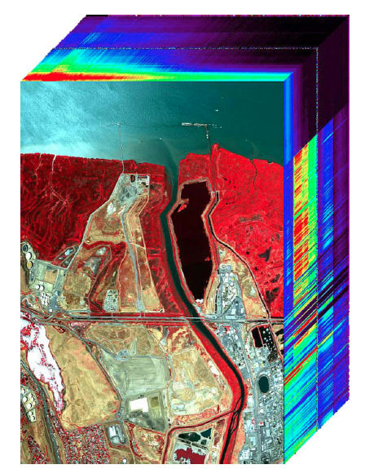
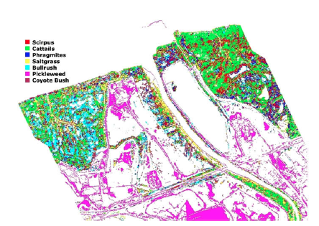
Example Data Set Land Classification
PROBE1 HSI Image
Ground Classification
Notes:
Probe1 Sensor -

Slide 34
Computation Costs
For Example LLE is:
KNN: O(N log N)
Finding Weights: O(N D K³)
Solving Eigenproblem: O(dN²)
Since N is the number of pixels in the image these calculations can become daunting

Slide 35
Software Flow

