Slide 1
Discontinuous Galerkin Methods for Solving Euler Equations
Final Presentation
May 7, 2013
Andrey Andreyev (andreyev@umd.edu)
Adviser: James Baeder (baeder@umd.edu)

Slide 2
Motivation
Computational Fluid Dynamics (CFD) is widely used in Engineering Design to obtain solutions to complex flow problems when testing is impossible or restrictively expensive. CFD is also used in conjunction with testing to increase confidence in the design process.
There are many methodologies for developing CFD codes but can be broken down into 3 categories:
Finite Difference Method
Finite Volume Method
Finite Element Method
Each has its advantages and disadvantages.
This work is focused on the 3rd category. A finite element method capable
of capturing discontinuities in the solution is developed. It’s appeal is lack
of need for a computational stencil, and it’s locality which lends itself to
parallelization.

Slide 3
Objectives:
Develop a Discontinuous Galerkin Method to solve the Euler Equations in one dimension that allows for up to 3rd spatial order discretization
Develop a Discontinuous Galerkin Method to Solve the Euler Equation in two dimensions that allows for up to 3rd order spatial discretization
Validate both codes against known solutions. Entropy Convection/Shock tube problem for the one dimensional case and an Isentropic Vortex/Double Mach Reflection Problem for the two dimensional case

Slide 4
Outline of Presentation
Euler Equation description
Overview of Current Numerical Methods in CFD
-Spatial Discretization Overview
-Overview of Conservative Methods
-Riemann Problem
Description of General Discontinuous Galerkin Method
-Slope Limiting of DG method for stability
-Time Stepping using 3rd order Runge Kutta
1D Problem Description
-Results/Validation
2D Problem Description
-2D Results/Validation
Summary
Review of Schedule
Description of deliverables

Slide 5
The Euler Equations
General Form
One Dimensional Form

Slide 6
Overview of Current Computational Approaches
Finite Difference Methods
Advantages:
Ease of Implementation
Easy to make higher order
Disadvantages:
Only applicable on structured grids
In general, methods in Computational Fluid Dynamics can be divided into three approaches:
Finite Element
Advantages:
Can be any order of accuracy
Based on variational methods
Applicable on unstructured grids
Disadvantages:
More complex
Not conservative!
Naturally implicit (can be explicit with modifications)
Finite Volume
Advantages:
Naturally Conservative (captures discontinuities in the flow field)
Many upwinding possibilities
Applicable on unstructured grids
Disadvantages:
Difficult to devise stable higher order scheme

Slide 7
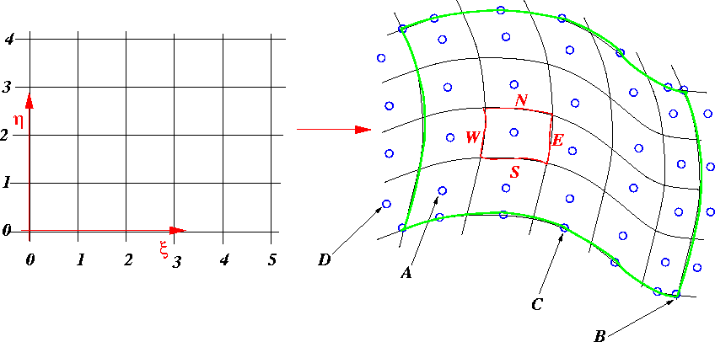
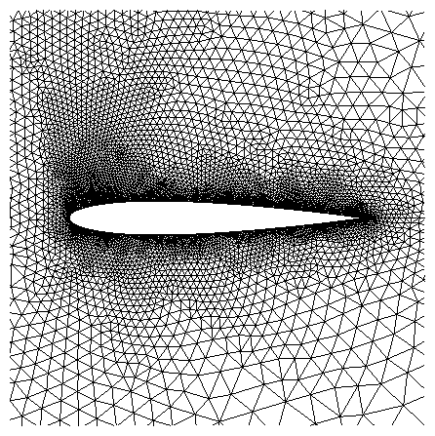
Spatial Discretization
Structured Mesh
Unstructured Mesh
Picture from: http://www.cgl-erlangen.com/downloads/Manual/ch09s16s01.html
Picture from: http://ta.twi.tudelft.nl/users/wesselin/projects/unstructured.html

Slide 8
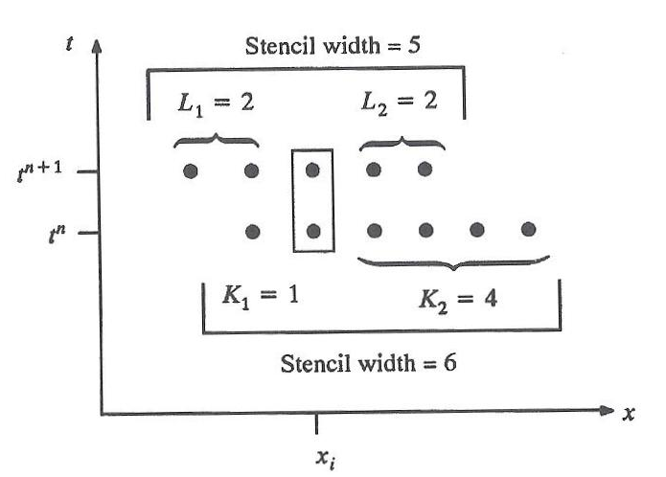
More on spatial discretization and accuracy
“Traditional” numerical methods require a stencil to approximate the spatial derivatives.
K=stencil for derivative at t^{n}
L=stencil for derivative at t^{n+1} (only applicable to implicit methods)
Picture of stencil
1st and 2ndorder first derivative approximation
Figure From
Computational Gasdynamics: Laney²

Slide 9
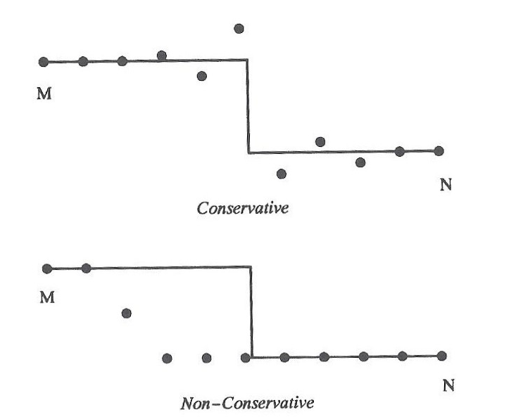
Discretization, Conservation and Flux Capturing
Require scheme to capture shocks and other discontinuities “automatically” and not using “shock fitting methods”
Higher spatial order shock capturing schemes (>2nd order) tend to be more oscillatory around the discontinuities because of the larger stencils required thus more points are contributing around areas with large gradients
Figure from
Computational Gasdynamics: Laney ²

Slide 10
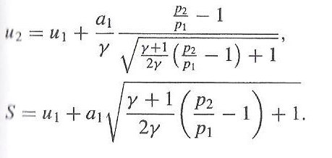
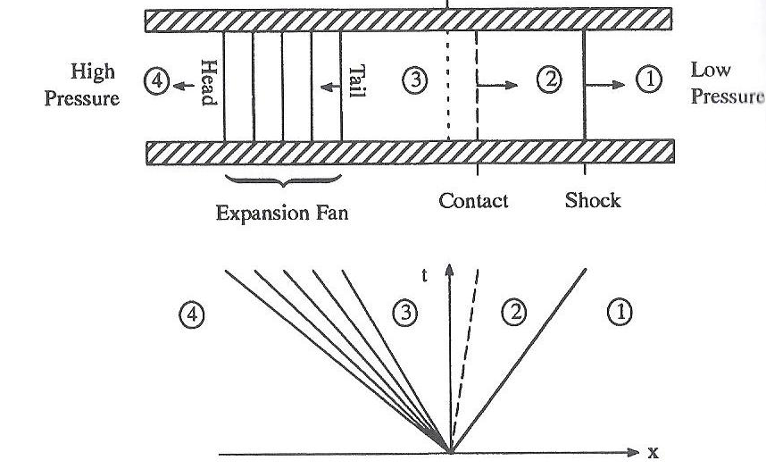
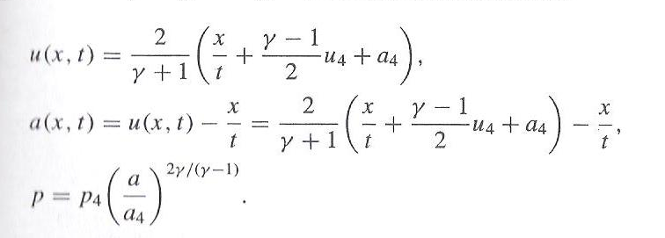
Exact solution to the Riemann Problem: Interface fluxes²
The second term of in the last equation has not been defined yet. How do we get the fluxes at the cell interfaces? The Riemann Problem has an exact solution!
Consider an Euler Equation with the initial of:
Expansion Fan:
Figure from
Computational Gasdynamics: Laney ²
Computational Gasdynamics: Laney ²

Slide 11
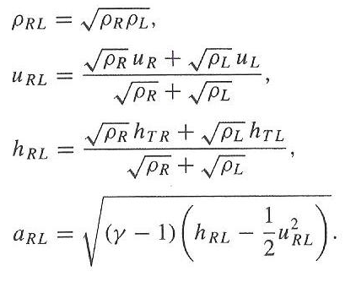
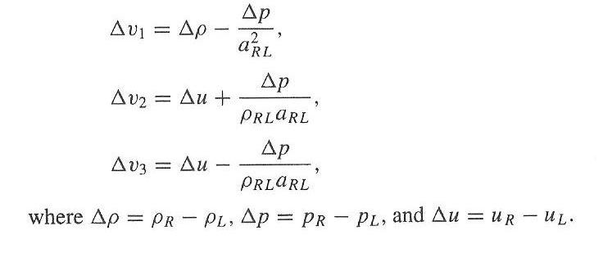
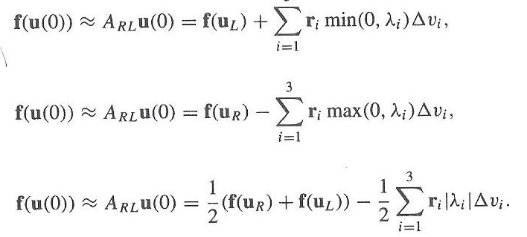
Consider that every cell interface is a Riemann problem!
Exact solution to Riemann problem is very expensive and we are not interested in in the solution at all x/t. Look for a suitable approximation for x/t=0 only via Roe Averages
All equations taken from Laney (2)

Slide 12
General Discontinuous Galerkin Setup
Notation:
Conservative variable quantities
Flux Vector
Approximate solution in one dimension
Approximate solution in two dimensions
Finite Element degrees of freedom
Shape functions
Weight functions (same as shape functions)

Slide 13
General Discontinuous Galerkin Setup
1. Start with the Euler Equation:
3. Multiply by weight function and integrate by parts
2. Discretize the spatial domain and assume and assume an approximate solution on a per-element basis
Note the boundary term has a different flux term. In normal finite element, the boundary terms need to enforce connectivity with neighboring elements. In Discontinuous Galerkin Methods the boundary fluxes are calculated using the Riemann Fluxes. This enforces connectivity and allows for discontinuities in the solution!
All Equations from Cockburn and Shu [1989] (1)

Slide 14
One-Dimensional Discontinuous Galerkin¹
Require an approximation to the solution in the form of:
Define the shape function as:
Define the degrees of freedom as:
Note:
1st DOF is the cell average of the conservative variables
In Galerkin method the weight functions are taken to be the same as the shape functions.
Multiplying the Euler Equations by the weight functions and substituting for U and integrating by parts, we obtain the following form:
All Equations from Cockburn and Shu [1989] (1)

Slide 15
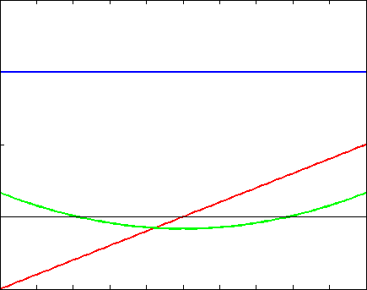
Shape Functions over each element
Constant shape function. 1st Order method
Quadratic Shape allows for quadratic variation. Makes method 3rd order in space
Linear Shape allows for linear variation. Makes method 2nd order
Author Generated

Slide 16
Slope Limiting for Stability¹
Around discontinuities DOFs representing the gradients are very large causing oscillations and instabilities. To remedy this problem slope limiters are introduced to insure stability
All Equations from Cockburn and Shu [1989] (1)

Slide 17
Runge-Kutta Time Explicit Time Marching
Time integration of the equations will be carried out using a higher order Runge-Kutta technique.
The space discretization in the previous slide converted the PDEs into a system of ODEs in time.
Using Higher Order Runge-Kutta, we carry out the time integration on a per-element basis
Note:
Time Step is calculated based on the largest Eigenvalue i.e. fastest information transfer
All Equations from Cockburn and Shu [1989] (1)

Slide 18
DG Method Approach
Require an approximation to the solution in the form of:
Step 1. Calculate the first term in the box (interface flux) using the Roe solver presented earlier
Step 2. Calculate the second term in the box using gauss
Step 3. Define the terms in the box as the residual
Step 4. Use 3rd Order Runge-Kutta to step in time
Step 5. Apply limiting at each solution update
All Equations from Cockburn and Shu [1989] (1)

Slide 19
DG Method 1D Test Problems
The method was tested on 3 problems
Entropy Convection Problem(Smooth solution, requires no limiting) used for validation
Sod’s Shock Tube Problem (Simple discontinuous solution, has analytical solution)
Osher’s Problem (Discontinuous Solution with complex flow structures, no analytical solution)

Slide 20
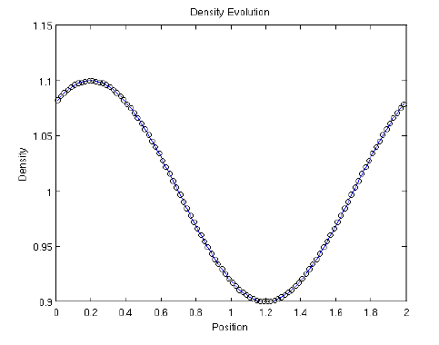
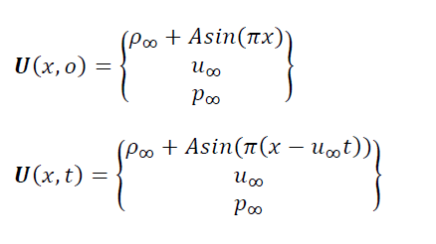
Testing 1D With no Limiter
3rd Order Implementation Developed Last Semester was very unstable and required more testing. Testing the implementation without flux limiting requires a problem with a smooth solution: Entropy Convection Problem
There was a bug that was modifying the solution during the residual calculation. Rewrote the implementation with more restriction of function access
Solution to Entropy Convection Problem ⁴
Author generated

Slide 21
2nd Order Spatial Discretization Results
Density Evolution

Slide 22
3rd Order Spatial Discretization Results
Density Evolution

Slide 23
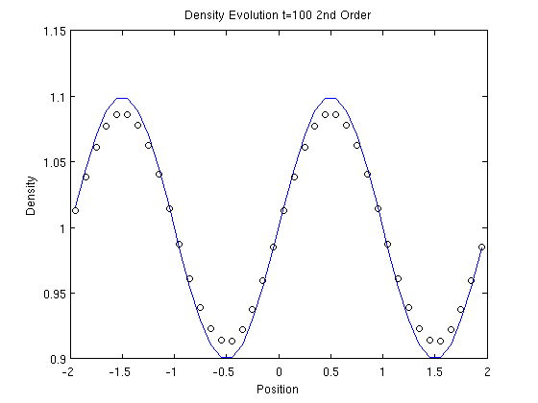
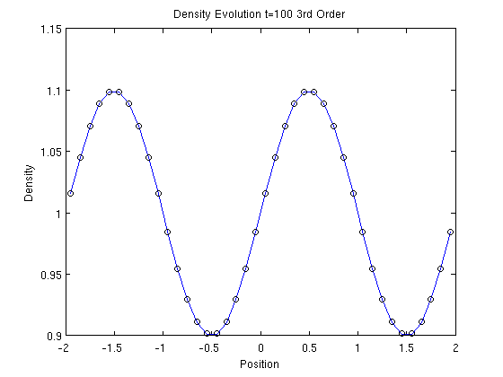
Numerical Diffusion of the Scheme
2nd order 40 cells t=100
3rd order 40 cells t=100
The 3rd Order scheme exhibits less numerical diffusion at t=100 sec

Slide 24
Validation using grid convergence criteria
The solution is run to 100 seconds to allow numerical diffusion to take effect. The norm of the error is calculated
The 3rd Order scheme is less diffusive, however the error goes down at the same rate as 2nd order scheme. This could be caused by the fact that time integration is also third order and 100 seconds is a considerable time length of integration

Slide 25
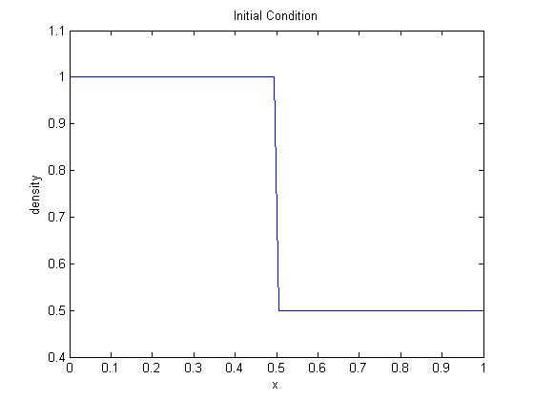
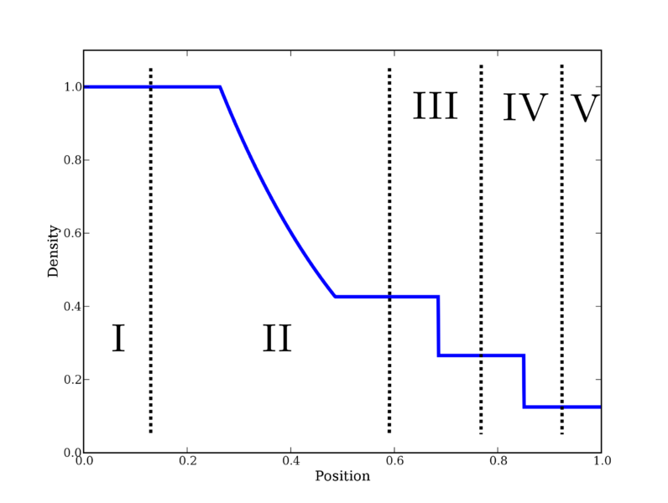
Sod’s Shock Tube Problem
Exact Solution
Image: Author Generated
Image: http://en.wikipedia.org/wiki/File:SodShockTubeTest_Regions.png

Slide 26
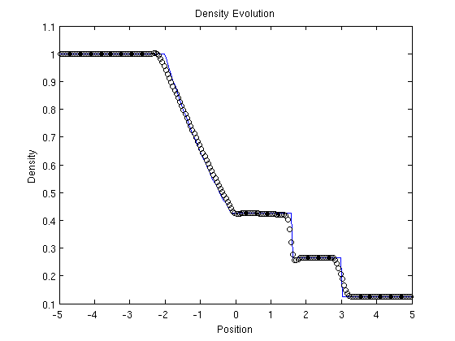
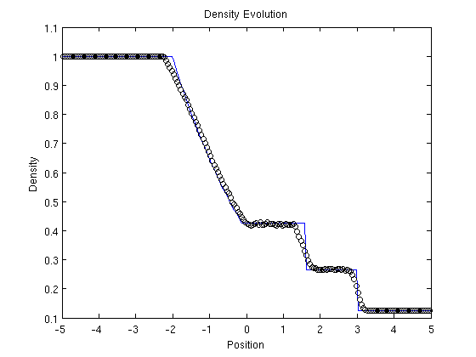
Sod’s Shock Tube Problem
2nd Order
3rd Order

Slide 27
Osher Problem
Now that the 3rd order method is proven to be stable, a more complicated problem can be solved that has a non-smooth solution
Interaction of entropy wave shown above with a shock wave. Requires flux limiting.
2nd Order
3rd Order

Slide 28
DG Method 2D
Problems to be solved:
Two Dimensional vortex convection on a structured mesh (analogous to entropy convection. Smoot Solution requires no limiting analytical solution exists)
Double Mach Reflection Wave (Mach 10 Requires Limiting, no analytical solution)

Slide 29
DG Method 2D Dimensions
The 3rd term in the week form requires a double integral. This is done using a tensor product of one dimensional quadrature¹. Note that the integrals are given on a unit square. A Jacobian of transformation also has to be calculated.
All equations from reference 1.

Slide 30
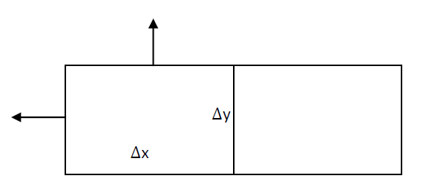
DG Method 2D Dimensions
(1)
The 2nd term in the week form is a line integral on the faces of the elements. It requires a an evaluation of the numerical solution (equation 1) at the cell boundaries, dotting it into the surface normal, obtaining the Roe Flux the same way as in 1D. This has to be done at all of the gauss points along the surface to obtain the integral.
All equations from ¹.

Slide 31
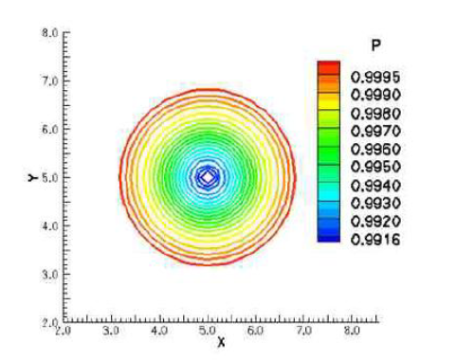
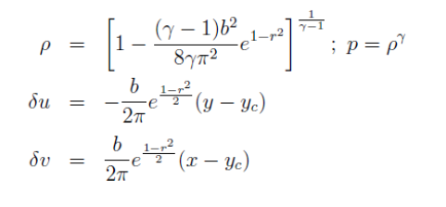
DG Method 2D Dimensions: IsentropicVortex Convection
The solution that will be used to test the code once it is complete:
The vortex should convect at the free stream velocity .
All equations and images from reference 4.

Slide 32
Isentropic Vortex Solution

Slide 33
2D Validation
Since the solution is known to be:
The solution is run out to 100 seconds. To allow numerical diffusion to take effect. A slice is taken through a constant y coordinate. The resulting one dimensional solution is compared to the exact solution. The norm of the error is taken
All equations and images from reference 4.

Slide 34
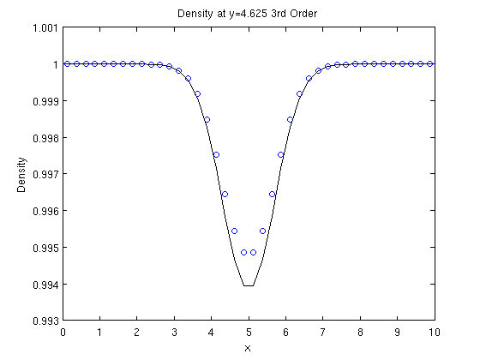
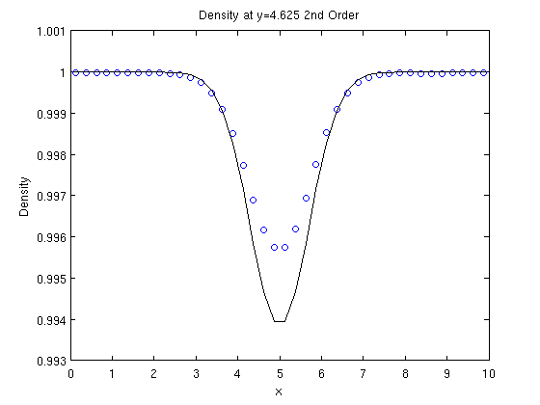
2D Validation
3rd Order 40X40 cells
2nd Order 40X40 cells
The 3rd Order exhibits less numerical diffusion after 100 seconds

Slide 35
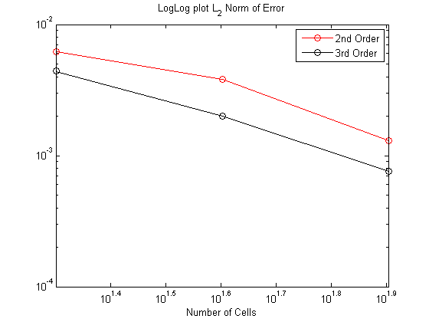
2D Validation
The slopes appear similar, but in this case the 2nd Order method exhibits super convergence and is actually > 2nd Order. The slope for both line is approximately 2.5. So the 3rd Order Method is not quite 3rd order accurate

Slide 36
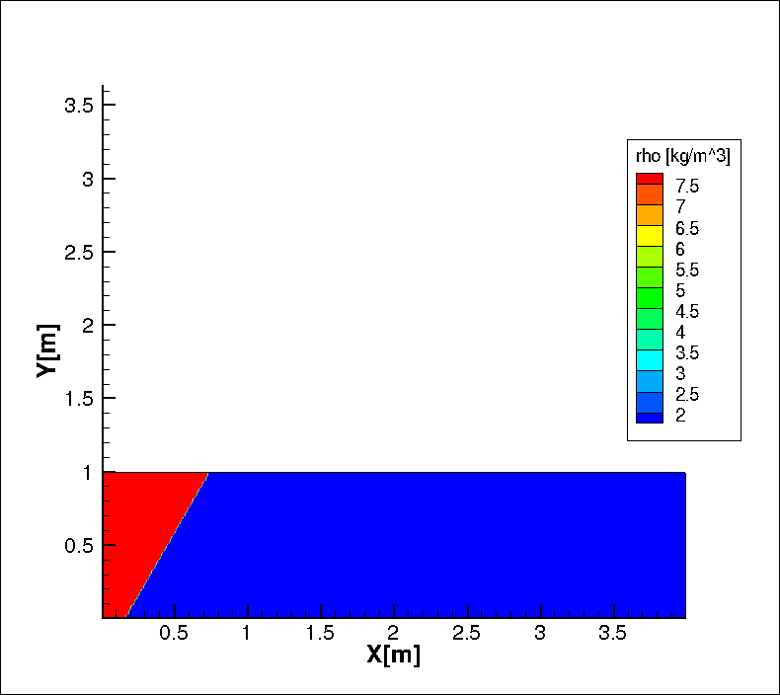
2D Validation
Initial shock at 60° Mach 10 wave with a inviscid wall boundary condition in front of the shock

Slide 37
Exact Solution Does Not Exist For The Double Mach Reflection Problem Visual Comparison Between Papers Is Required

Slide 38
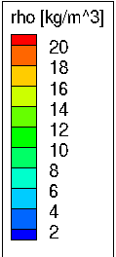
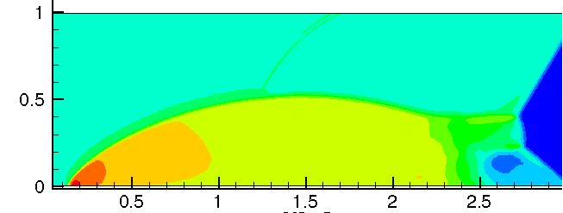
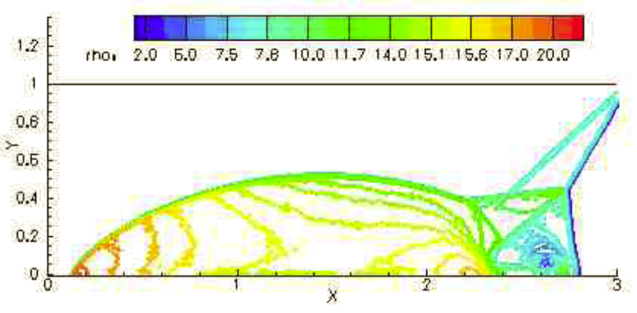
Solution 3rd Order DG 480X120 Cells t=0.2 seconds
Solution from ⁴ 480X120 Cells t=0.2 seconds

Slide 39
Summary of Visual Inspection of Double Mach Reflection Problem
The overall structure of the solution is comparable
The back end of the shock for the DG method is more slanted. This is not desirable
The flow structure directly after the shock has similar characteristics, but the smearing is worse on the DG method
Since the smooth solution (Isentropic Vortex) of the DG method agrees with the exact solution, the disparity between the solution of the Double Mach Reflection Problem has to be attributed to the limiter.
At Mach 10, the limiter had to be strengthened to stabilize the solution. Meaning the comparison of the slope with was not strong enough to stabilize the solution.
The limited slope had to be multiplied by a factor (parameter of the code).
DG limiters are not as well defined as those for Finite Volume

Slide 40
Summary of Project
1-D
The one dimensional version of DG method was developed and tested using a smooth solution (entropy convection) and two discontinuous solutions (Sod’s Shock Tube and Osher’s problem)
Results were compared to exact solution of entropy convection at t=100 seconds
3rd Order Proved to be less diffusive, but not formally 3rd order in space. Requires more investigation, possible a different definition of error due to time-based error.
Limiter captures the shock, but diffuses the solution
2-D
The two dimensional problem of DG was developed and tested using a smooth solution (Isentropic Vortex) and a discontinuous solution (Double Mach Reflection Wave)
Error estimates pending
The limiter allowed for discontinuous solution, but had to be strengthened due to the very large gradients. The solution was comparable to previous works, but did smear the solution near the shock

Slide 41
Original Implementation Schedule
10/31/12- One dimensional version. Apply to one dimensional problem with a known solution to test accuracy and shock capturing abilities. Sod shock tube problem. Will validate the 1-D version (serial)
12/15/13- Two dimensional version. Apply to 2-D airfoil problem using provided grids (serial)
02/15/13- Validation of the two dimensional version using experimental airfoil results as well as the results published in literature
03/15/13- Parallelization of the two dimensional. Validate using results from the serial version
04/15/13- Implementation of the strand mesh generation. Validation is trivial since the problem is geometric in nature and visual inspection of the resulting mesh will suffice.
Time Permitting- Integration of the strand methods into the DG Flow Solver
End of Semester- Final Report

Slide 42
DG Method Implementation Revisesd Schedule
01/20/13- Complete and validated one dimensional Discontinuous Galerkin Code up to 3rd order accurate in space
02/01/13- Complete and validated one dimensional Discontinuous Galerkin Code up to 3rd order accurate in space (still need to verify 3rd order spatial convergence, but the code is stable)
03/31/13- Two dimensional solution of the vortex convection problem to test spatial order of accuracy without limiting (analogous to entropy convection in one dimension). With validation
04/30/13- Two dimensional solution of vortex-shock interaction problem to test the shock capturing capabilities as well as the limiter. (Estimate delivery date because of possible unforeseen complications). With validation
Time permitting- Boundary treatment such as inviscid wall applied to allow for solutions to airfoils
05/14/13- Final Report and 1D and 2D code

Slide 43
Questions???

Slide 44
References:
1. Bernardo Cockburn, Chi-Wang Shu, The Runge-Kutta Discontinuous Galerkin Method for Cnservation Laws V, Multidimensional Systems, Journal of Computational Physics 141 199-224 (1997)
2. Bernardo Cockburn, Chi-Wang Shu, TVB Runge-Kutta Local Projection Discontinuous Galerkin Method for Conservation Laws II: General Frame Work Mathematics of Computation Volume 52 186 (1989)
3. Culbert B. Laney. Computational Gasdynamics. Cambridge University Press. 1998
4. D. Gosh, Compact-Reconstruction Weighted Essentially Non-Oscillatory Schemes for Hyperbolic Conservation Laws. Doctor of Philosophy Thesis, University of Maryland, College Park 2012.

