Slide 1
Reduction of Temporal Discretization Error in an Atmospheric General Circulation Model (AGCM)
Author: Daisuke Hotta
hotta@umd.edu
Advisor: Prof. Eugenia Kalnay
Dept. of Atmospheric and Oceanic Science,
University of Maryland, College Park
ekalnay@atmos.umd.edu

Slide 2
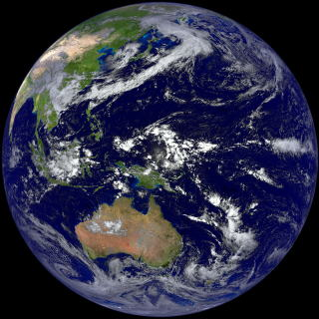
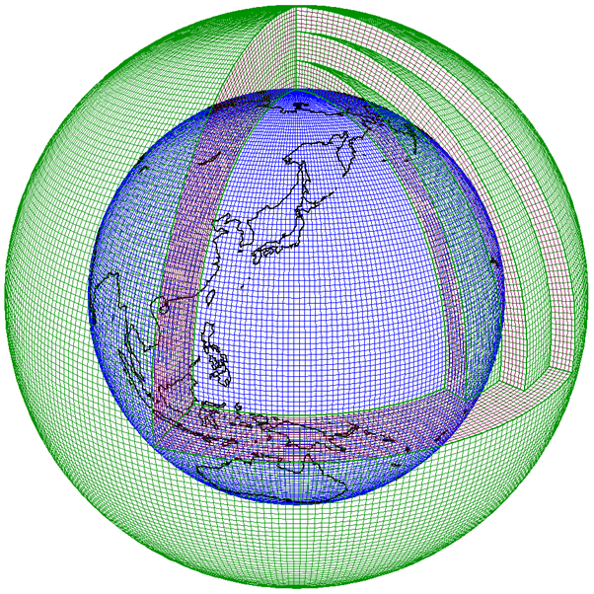
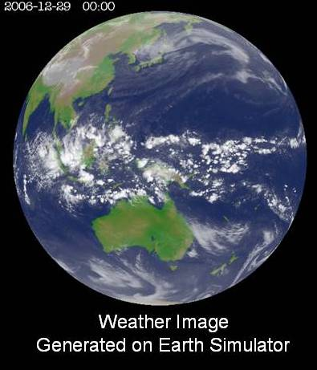
Numerical Weather Prediction (NWP):
= Initial Value Problem of PDE
Atmospheric Phenomena
Governing Equations
Numerical
Discretization
Solve !
(Simulate)
from http://www.jma.go.jp/jma/jma-eng/jma-center/nwp/nwp-top.htm
(Real Atmosphere)
(from JMA website)
Simulated Atmosphere
from http://iprc.soest.hawaii.edu/news/news_2009.php
Hydrodynamic PDE
O(10⁹)-dimensional ODE
AGCM: Atmospheric General Circulation Model
= a computer program which simulates the flow of global atmosphere by numerically integrating the governing fluid dynamical PDEs

Slide 3
Introduction: Motivation
Due to computational restrictions …
most AGCMs adopt low-order time-integration schemes, such as
Leap-frog with Robert-Asselin filter (1st order)
Explicit Backward Euler (aka. Matsuno; 1st order)
Often, Δt is taken as the largest value for which computational instability is suppressed,
under the premise that temporal discretization errors are negligible compared to those associated with spatial discretization or Physical Parameterizations.

Slide 4
Introduction: Motivation
However …
Spatial resolutions become finer and finer as the supercomputers become faster.
Is the premise justifiable ?
If not, how can we alleviate such errors ?
Remedies (Approaches) :
Use a more accurate scheme with the same computational cost
Identify and parameterize the error, and reduce it using data assimilation

Slide 5
Approach 1 : A Better integration scheme (Lorenz N-cycle)
Lorenz (1971) proposed an incredibly smart time-integration scheme which:
requires only 1 function evaluation per step
but yet (every N steps) it is of
- (up to) 4th-order accuracy (for nonlinear systems)
- arbitrary order of accuracy (for linear systems)
However, this scheme seems to have remained forgotten.
No applications have been made to AGCMs.
➔ Apply Lorenz N-cycle to an AGCM (Phase 1)

Slide 6
Approach 2: Estimation and Reduction of Model Errors
Danforth et al. (2007)
Training:
Compute bias of the model error
Construct covariance matrix of the model state and the model error
Extract dominant modes using Singular Value Decomposition (SVD)
Model Error Reduction:
Estimate the model errors using bias statistics (state-independent) and regression in the space spanned by Singular Vectors (SVs) (state-dependent)
Reduce the error by subtracting the estimated error each time step during the integration
➔ Try this technique with an AGCM (Phase 2 & 3)

Slide 7
Phase 1: Approach
Implement Lorenz N-cycle to an existing AGCM
Implement 4th order Runge-Kutta as well as a reference
Compare the accuracy and efficiency of the newly introduced schemes with the original scheme

Slide 8
Phase 1: Algorithms
ODE to be solved:
(existing) Leap-frog with
Robert-Asselin Filter
Lorenz N-cycle
4th order Runge-Kutta
Memory consumption:
2 x dim{model state}
Memory consumption:
2 x dim{model state}
Memory consumption:
5 x dim{model state}
F-evaluation: 1 per time step
F-evaluation: 1 per time step
F-evaluation: 4 per time step
accuracy: (N <= 4)
O((NΔt)^{N}) (every N steps)
O(NΔt ) (in between)
accuracy:
O(Δt )
accuracy:
O(Δt⁴ )

Slide 9
AGCM: SPEEDY model
A fast AGCM with simplified physical parameterizations
Developed in Italy by Drs. F. Molteni and F. Kucharski
Horizontal Discretization:
Spectral Representation with Spherical Harmonics
truncated at total wavenumber 30 (T30)
Vertical Discretization:
8-layers Finite Difference on σ-coordinate
Temporal Discretization:
Leap-Frog scheme with Robert-Asselin Filter
(1st order Forward Euler for the physical parameterizations)

Slide 10














The equations solved: the “primitive” equation system (PDEs) on a spherical geometry + parametrized processes
Dynamical Core
Sub-grid Parametrizations
…..

Slide 11
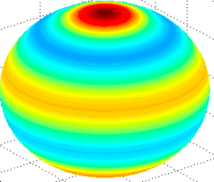
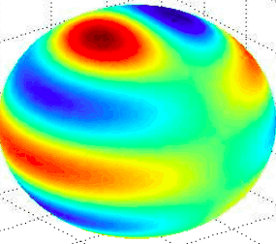
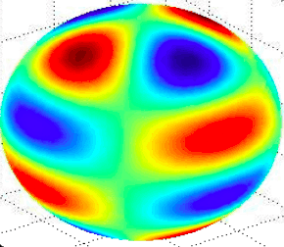
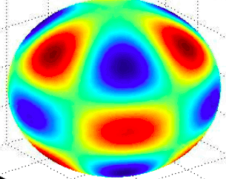
Spatial discretization:
Spectral representation w.r.t. Spherical Harmonics
Spherical geometry: straightforwardly treated by spectral representation :
By the use of spherical harmonics expansion, differentiation becomes algebraic operation to the coefficients
e.g. Laplacian
images taken from
http://en.wikipedia.org/Spherical_harmonics

Slide 12
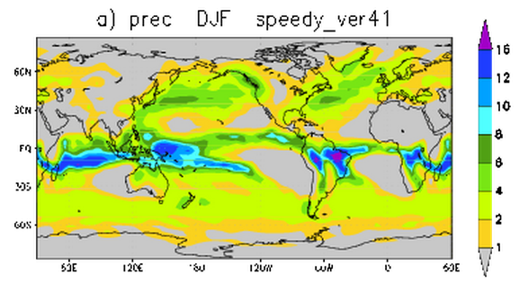
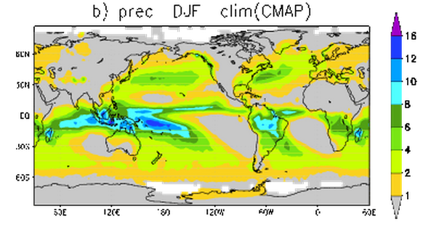
AGCM: SPEEDY model
Model Output
= (simulated) Global Weather or Climate
Simulated Winter Precipitation (rain fall)
Observed Winter Precipitation (rain fall)
Images cited from http://users.ictp.it/~kucharsk/speedy8_clim_v41.html

Slide 13
AGCM: SPEEDY model
Language: Fortran77
Platform: Any machine which supports Fortan77 compiler (a Linux server will be used in this study)
Code statistics: ∼10,000 lines, 73 files
# predicted variables: ∼ Ο(10⁵)
Implementation to be made:
Add new subroutines for N-cycle schemes and 4th order Runge-Kutta scheme
(for validation)
Add an Option to Switch-off Physical Parameterizations
Add an Option to run with flat orography

Slide 14
Phase 1: Issues to be avoided
Complications due to Physical Parameterizations:
Physical parameterizations include discontinuous processes (such as “if”-branches).
➔ Avoid complications by switching-off parameterizations in the validations

Slide 15
Phase 1: Validation and Testing
Compare the new code with the original code
Switch-off parametrizations, remove orography (mountains), and perform Jablonowski-Williamson dynamical core tests (Jablonowski 2006):
Steady-state test case: start from steady-state initial condition, and see if the model can maintain that state.
Baroclinic wave test case: run the model from a specified initial condition. Analytical solution does not exist, but a reference solution (with uncertainty range) is available.

Slide 16
Phase 1: Database
Reference Solutions for the Jablonowski-Williamson Baroclinic wave test case
available from the University of Michigan website
http://esse.engin.umich.edu/groups/admg/ASP_Colloquium.php
http://www-personal.umich.edu/~cjablono/dycore_test_suite.html
Generated from 4 high-resolution models (approx. 50km mesh)
Uncertainty estimate evaluated as the difference among those high-resolution models is also available.

Slide 17
Phase 1: Validation (detail)
Run the models, with the original scheme (Leap-Frog) and the new schemes (Runge-Kutta 4th and Lorenz N-cycle), from the specified initial condition.
Compute RMS difference of the surface pressure with respect to the reference solution.
If the new schemes are no further to the reference solution than to the original scheme, we can conclude that the implementation is successful.

Slide 18
Plot the RMS difference || p_{s}– p_{s}^{REF}||
If the plot looks like below:
Success
If the plot looks like below:
Failure
Original
New
New
Original
Uncertainty
Estimate
Uncertainty
Estimate

Slide 19
Approach 2: Estimation and Reduction of Model Errors
Danforth et al. (2007)
Training:
Compute bias of the model error
Construct covariance matrix of the model state and the model error
Extract dominant modes using Singular Value Decomposition (SVD)
Model Error Reduction:
Estimate the model errors using bias statistics (state-independent) and regression in the space spanned by Singular Vectors (SVs) (state-dependent)
Reduce the error the model state through nudging each time step during the integration
➔ Try this technique with an AGCM (Phase 2 & 3)

Slide 20
Phase 2: Approach
Take the Truth from NCEP/NCAR reanalysis (Kalnay et al. 1996)
NCEP=National Centers for Environmental Prediction
NCAR=National Center for Atmospheric Research
Extract model errors by applying the method of Danforth et al. (2007) to the models with:
the original scheme (Leap-Frog; M^{LF})
Runge-Kutta 4th order scheme (M^{RK4})
Lorenz N-cycle scheme (M^{NCYC})
(time permitting) Correct the model errors on-line during the course of model integration
(➔ Phase 3&4)

Slide 21
Phase 2: Algorithm
Generate initial values from the Truth (NCEP/NCAR reanalysis)
Perform short-range forecasts using the 3 models (M^{LF}, M^{RK4}, M^{NCYC4}) from the initial conditions
find the bias of the model errors for each model
Build the covariance matrix
Extract the dominant modes by conducting SVD

Slide 22
Phase 2: Implementation
Programs to be implemented:
computation of the bias and the covariance matrix
a program to perform SVD to the covariance
Platform:
Linux server on AOSC dept.’s network
Language: Fortran90

Slide 23
Phase 2: Validation
For the SVD code:
Prepare a small-dimensional dummy data and run the program for this small data
Check if the result agrees with the result obtained by Matlab package.
For the entire implementation:
Check if the the model errors obtained for M^{LF} agrees with Danforth et al. (2007)

Slide 24
Phase 2: Testing (Verification)
Compare the amplitude of model errors (bias and covariance) for the new schemes (M^{RK4} and M^{NCYC}) with those for the original scheme M^{LF}
If the errors are smaller for the new schemes
➔ Successful
Otherwise ➔ Unsuccessful

Slide 25
Deliverables
Phase 1:
Upgraded code for SPEEDY model
- subroutines for Lorenz N-cycle and 4th order Runge-Kutta
Test-case results for the SPEEDY model (both for the original scheme and the new schemes)
Phase 2:
Archive of the model errors
Pairs of Singular Vectors for the model state and the model error
Code for performing SVD

Slide 26
Schedule and Milestones
Phase 1:
Phase 2:
Implement RK4 and N-cycle, Nov.
Write the mid-year report, prepare the oral presentation, Dec.
Switch-off physical parameterizations, prepare flat topography, Jan.
perform the dynamical core tests. Feb.
Generate initial values from the NCEP/NCAR reanalysis, end of Feb.
build the bias and covariance matrix, Mar.
Code and test a program for SVD, Apr.
Compare the model errors for the new and the original shcmes, May.
Write the final report, May.

Slide 27
Phase 3 (If time allows): Model Correction
During the integration of M^{LF}, on each time step,
Correct the model bias within the model.
estimate the model error by regressing the model state onto the model error in the space spanned by the SVs.
Correct the 1-step forecast by subtracting the estimated error

Slide 28
Phase 4 (if time allows):
Repeat Phase 2&3 with data assimilation
Generate nature-run by running M^{RK4}
Add random numbers to the nature-run to generate pseudo-observations
Perform data assimilation with SPEEDY-LETKF (Miyoshi 2005)
Compute the model error assuming the analysis is the truth, and repeat Phase 2 & 3

Slide 29
Bibliography
Lorenz N-cycle
Lorenz, Edward N., 1971: An N-cycle time-differencing scheme for stepwise numerical integration. Mon. Wea. Rev., 99, 644–648.
SPEEDY model
Molteni, Franco, 2003: Atmospheric simulations using a GCM with simplified
physical parameterizations. I. Model climatology and variability in
multi-decadal experiments. Clim. Dyn., 20, 175-191.
Kucharski F, Molteni F, and Bracco A, 2006: Decadal interactions between the western tropical Pacific and the North Atlantic Oscillation. Clim. Dyn., 26, 79-91
SPEEDY-LETKF
Miyoshi, T., 2005: Ensemble Kalman filter experiments with a primitive-equation global model. Ph.D. dissertation, University of Maryland, College Park, 197pp.
Atmospheric GCM Dynamical Core test cases
Jablonowski, C. and D. L. Williamson 2006: A baroclinic instability test case for atmospheric model dynamical cores, Q. J. R. Metorol. Soc., 132, 2943-2975
NCEP/NCAR reanalysis
Kalnay, E., and Coauthors, 1996: The NCEP/NCAR 40-Year Reanalysis Project. Bull. Amer. Meteor. Soc., 77, 437–471.
Model Error Correction
Danforth, Christopher M., Eugenia Kalnay, Takemasa Miyoshi, 2007: Estimating and Correcting Global Weather Model Error. Mon. Wea. Rev., 135, 281–299.
Danforth, Christopher M., Eugenia Kalnay, 2008: Using Singular Value Decomposition to Parameterize State-Dependent Model Errors. J. Atmos. Sci., 65, 1467–1478.

