Slide 1
Modeling Imatinib-Treated Chronic Myeloid Leukemia Cara Peters cpeters3@math.umd.edu
Advisor: Dr. Doron Levy
dlevy@math.umd.edu
Department of Mathematics
Center for Scientific Computing and Mathematical Modeling

Slide 2
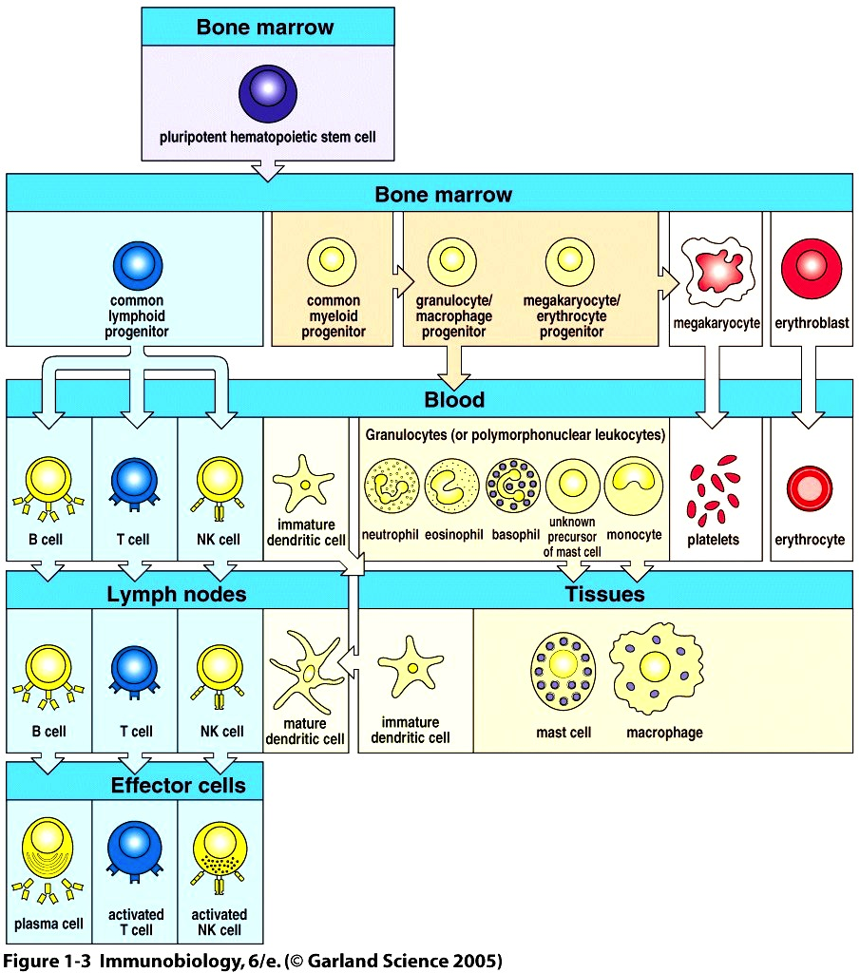
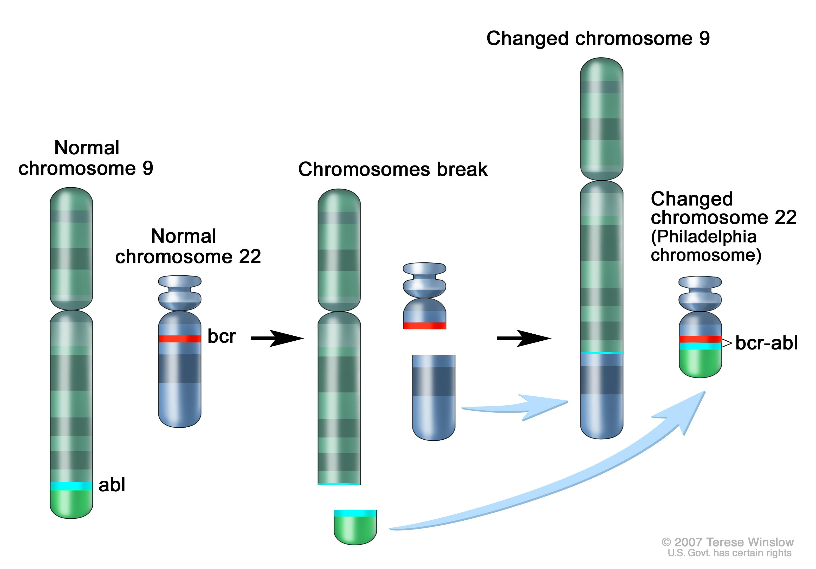
Introduction
CML – cancer of the blood
20% of all leukemia
Genetic mutation in hematopoietic
stem cells – Philadelphia Chromosome (Ph)
Increase tyrosine kinase activity allows for
uncontrolled stem cell growth
Treatment –
Imatinib: tyrosine kinase inhibitor
Controls population of mutated cells
Not effective as a cure
Figure: Chronic Myelogenous Leukemia Treatment. National Cancer Institute. 21 Sept. 2015. Web.

Slide 3
Cell State Diagram (Roeder et al., 2006)
Stem cells
Non-proliferating (A)
Proliferating (Ω)
Precursor cells
Mature cells
Circulation between A and Ω based on cellular affinity
High affinity: likely to stay in/switch to A
Low affinity: likely to stay in/switch to Ω
Ph⁺ cells affected during the G₁ phase of the cell cycle
Figures: Kim et al. in Bull. Math. Biol. 70(3), 728-744 2008
Notes:
3 stages of cell differentiation (Stem, Precursor, Mature) with Stem cells divided into two compartments.
Stem cells:
Non-proliferating (A): cellular affinity increases at each time step by a factor r, until max affinity reached
Transitions to Ω with probability ω
Proliferating (Ω): stem cells complete the cell cycle (G₁, S, G₂, M: 48 hour cycle)
Cells enter Ω at c(t) = 32 (S stage: DNA synthesis)
At c(t)=48, c reset to zero, stem cell divides into two daughter cells. Cycle begins with G₁
Transitions to A during G₁ with probability α
Cellular affinity decrease at each time step by a factor d until min affinity when it becomes a Precursor
Precursor cells:
Proliferate for 20 days then mature
Divide once/day
Mature cells
No division
Live for 8 days

Slide 4
Project Goal
Follow dynamics of CML under drug therapy
Questions
How long does disease genesis take?
With treatment, does a steady state occur? What does it look like?
What are the transition rates between A and Ω?
Drug administration – when, how often?

Slide 5
Approach
Mathematically model clinically observed phenomena of three non-interacting cell populations
Nonleukemia cells (Ph⁻)
Leukemia cells (Ph⁺)
Imatinib-affected leukemia cells
Three model types based on cell state diagram
Agent Based Model (Roeder et al., 2006)
System of Difference Equations (Kim et al., 2008)
PDE (Kim et al., 2008)
Parameter values based on clinical data

Slide 6
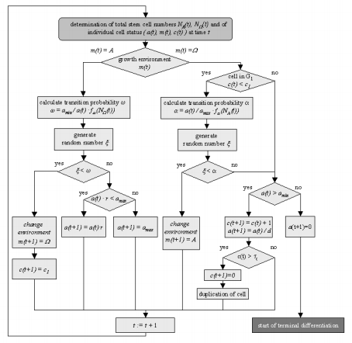
Model 1: Roeder et al., 2006
Single cell-based stochastic model
Individual cells simulated according to set rules
Rules applied at each time step, simultaneously update status of all cells
A(t), Ω(t) determined then stem cell populations updated
CML genesis modeled starting with nonleukemia cells only
Alter f_{α}, f_{ω} of a single proliferating stem cell, track as Ph⁺
Imatinib treatment
Alteration of f_{ω} for Ph⁺ cells to new value with probability r_{inh}
Ph⁺ proliferative cells killed with probability r_{deg}
Complexity based on number of agents
~10⁵ cells
Down-scaled to 1/10 of realistic values

Slide 7
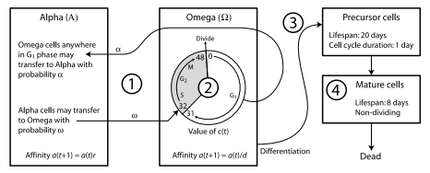
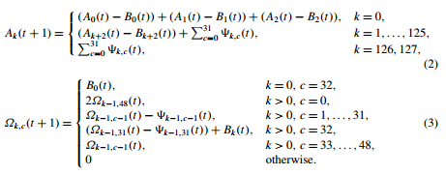
Model 2: Kim et al., 2008
Reduce complexity of ABM to attain simulation of realistic number of cells
Figures: Kim et al. in Bull. Math. Biol. 70(3), 728-744 2008
Notes:
Cell affinity discretized so that log(a(t)) is a linear function of k
Total number of stem cells determined by summing A_{k}(t) over all values of k, Ω_{k,c}(t) over all values of k and c
k denotes cell affinity level, c denotes position in cell cycle
Stem cell equations:
A cells, line 2:
First term: number of cells with affinity k+2 at time t that remain in A at time t+1
Second term: number of cells with affinity k that transition from Ω
Ω cells, line 4: cells beginning the S phase of the cell cycle
First term: number of cells remaining in Ω affinity decreases, position in cell cycle increases
Second term: cells in Ω transitioning to A
Third term: cells transitioning from A
B_{k} and ψ_{k,c} are binomial random variables
N (number of trials): A_{k}(t), Ω_{k,c}(t) respectively
P (probability of success): α, ω respectively
Differentiated cell equations:
Precursor cells, line 2:
Every day (24 hours) cells divide.
Mature cells, line 2:
Cells no longer divide

Slide 8
Model 3: Kim et al., 2008
Transform model into a system of first order hyperbolic PDEs
Consider the cell state system as a function of three internal clocks
Real time (t)
Affinity (a)
Cell cycle (c)
Each cell state can be represented as a function of 1-3 of these variables
Numerical Simulation
Explicit solvers
Upwinding
Composite trapezoidal rule
First order time discretization
Figures: Kim et al. in Bull. Math. Biol. 70(3), 1994-2016 2008

Slide 9
Implementation
Implementation Hardware
Asus Laptop with 8 GB RAM
Implementation Language
Matlab R2014a

Slide 10
Validation
ABM and Difference Equations
Run simulations with low cell count
increase to realistic numbers
Replication of figures, achieve similar
cell count values
PDE
Verify PDE method works by testing on scalar first order hyperbolic PDEs with known result
$u_{t}+au_{x}=0$
$u_{t}+u_{x}+ u_{y}=0$
Figure: Kim et al. in Bull. Math. Biol. 70(3), 728-744 2008

Slide 11
Testing
PDE model
Adapt code to CML specific PDE system
Verify results based on figures and values
in Kim et al.
Test all models with new parameter values determined from clinical data of a new set of CML patients
Figure: Kim et al. in Bull. Math. Biol. 70(3), 1994-2016 2008

Slide 12
Project Schedule
Phase 1: October – early November
Implement difference equation model
Improve efficiency and validate
Phase 2: November – early December
Implement ABM
Improve efficiency and validate
Phase 3: December – mid February
Implement basic PDE method and validate on simple test problem
Phase 4: mid February – April
Apply basic method to CML - Imatinib biology and validate
Test models with clinical data

Slide 13
Deliverables
Matlab Code
Agent Based Model
Difference Equations Model
PDE model
Database of parameter values and initial conditions
Figures produced during validation and testing
Proposal Document and Presentation
Mid Year Report and Presentation
End of Year Report and Presentation

Slide 14
References
Roeder, I., Horn, M., Glauche, I., Hochhaus, A., Mueller, M.C., Loeffler, M., 2006. Dynamic modeling of imatinib-treated chronic myeloid leukemia: functional insights and clinical implications. Nature Medicine. 12(10): pp. 1181-1184
Kim, P.S., Lee P.P., and Levy, D., 2008. Modeling imatinib-treated chronic myelogenous leukemia: reducing the complexity of agent-based models. Bulletin of Mathematical Biology. 70(3): pp. 728-744.
Kim, P.S., Lee P.P., and Levy, D., 2008. A PDE model for imatinib-treated chronic myelogenous leukemia. Bulletin of Mathematical Biology. 70: pp. 1994-2016.

