Slide 1
Government Statistics Research Problems and Challenge
Yang Cheng
Carma Hogue
Governments Division
U.S. Census Bureau
Disclaimer: This report is released to inform interested parties of research and to encourage discussion of work in progress. The views expressed are those of the authors and not necessarily those of the U.S. Census Bureau.

Slide 2
Governments Division
Statistical Research & Methodology
Program Research Branch
Sampling Frame Research and Development Branch
Statistical Methods Branch
Sample design
Estimation
Small area estimation
Governments Master Address File
Government Units Survey
Coverage evaluations
Nonresponse bias studies
Evaluations
Selective editing
Imputation

Slide 3

Committee on National Statistics Recommendations on Government Statistics
Issued 21 recommendations in 2007
Contained 13 recommendations that dealt with issues affecting sample design and processing of survey data
Notes:
Examples:
4-1 Study the effects of sample design changes on the accuracy of the data
4-3 Deals with the need to completely document nonresponse and cautions us to comply with statistical standards to fully report response rates
4-5 Calls for nonresponse bias studies
4-7 Asks us to examine the use of model-based estimates to yield improved estimates of small domains
Governments Division Report Series available on our Intranet site. New publications page available soon.

Slide 4
The 3-Pronged Approach
Data User Exchanges
Research Program
Modernization and Re-engineering

Slide 5
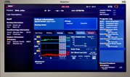
Dashboards
Monitor nonresponse follow-up
  Measures check-in rates
  Measures Total Quantity Response Rates
  Measures number of responses and response rate per imputation cell
Monitor editing
Monitor macro review

Slide 6
Governments Master Address File (GMAF) and Government Units Survey (GUS)
GMAF is the database housing the information for all of our sampling frames
GUS is a directory survey of all governments in the United States

Slide 7
Nonresponse Bias Studies
Imputation methodology assumes the data are missing at random.
We check this assumption by studying the nonresponse missingness patterns.
We have done a few nonresponse bias studies:
  2006 and 2008 Employment
  2007 Finance
  2009 Academic Libraries Survey
Notes:
2006 Employment: Louisiana and Mississippi – very low response rates
Looked at TX, AL, LA, MS and found that the NR in LA and MS were predominantly in the coastal regions of the states – where hurricanes Katrina and Rita hit
Obviously employment in those regions of LA and MS would not be like the employment in the non-hurricane affected northern part of the states.
Could not impute LA’s NR with the respondents from the northern part of the state.
2007 Finance – Low response rates in DE and NM – below our standards.
NR studies showed that this was due to drainage ditch districts and did not affect final estimates
Also showed that other states had problems with an inadequate response from their medium-sized units
Should have known earlier

Slide 8
Quality Improvement Program
Team approach
Trips to targeted areas that are known to have quality issues:
  Coverage improvement
  Records-keeping practices
  Cognitive interviewing
  Nonresponse follow-up
Team discussion at end of the day

Slide 9
Outline
Background
Modified cut-off sampling
Decision-based estimation
Small-area estimation
Variance estimator for the decision-based approach
9

Slide 10

Background
Types of Local Governments
Counties
Municipalities
Townships
Special Districts
Schools
Notes:
There are 89,476 local governments
Two that are in red are particularly problematic. Many small townships in the Midwest that contribute very little to the final estimates. Likewise, many special districts are extremely small. They are often in the legislation several years before they become active. Some are never active.

Slide 11
Survey Background
Annual Survey of Public Employment and Payroll
Variables of interest: Full-time Employment, Full-time Payroll, Part-time Employment, Part-time Payroll, and Part-time Hours
Stratified PPS Sample
50 States and Washington, DC
4-6 groups: Counties, Sub-Counties (small, large cities and townships), Special Districts (small, large), and School Districts

Slide 12
Distribution of Frequencies for the 2007 Census of Governments: Employment
Government Type | N | Total Employees | Total Payroll | 2008 n | 2009 n
State | 50 | 5,200,347 | $17,788,744,790 | 50 | 50
County | 3,033 | 2,928,244 | $10,093,125,772 | 1,436 | 1,456
Cities | 19,492 | 3,001,417 | $11,319,797,633 | 2,609 | 3,022
Townships | 16,519 | 509,578 | $1,398,148,831 | 1,534 | 624
Special Districts | 37,381 | 821,369 | $2,651,730,327 | 3,772 | 3,204
School Districts | 13,051 | 6,925,014 | $20,904,942,336 | 2,054 | 2,108
Total | 89,526 | 19,385,969 | $64,156,489,693 | 11,455 | 10,464
Source: U.S. Census Bureau, 2007 Census of Governments: Employment
Notes:
The Governments Division at the Census Bureau publish many aggregate estimates and because of this we wish to reduce the number of smaller units in the overall sample design
This table shows:
About 90,000 governments in the US
About half of them are townships and special districts
But these townships and special districts only amount to about 7% of total employees and total payroll
Which poses the question:
How do we sample such that we are more likely to draw the larger units into the sample?

Slide 13
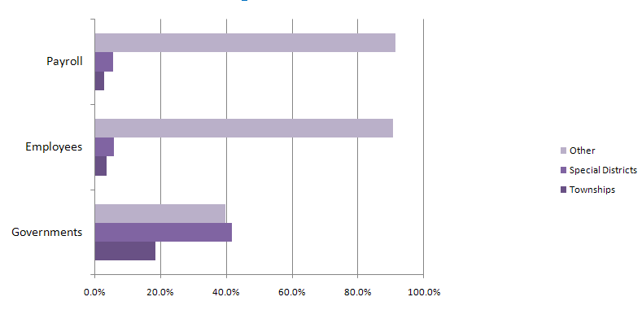
Characteristics of Special Districts and Townships
Source: 2007 Census of Governments
13

Slide 14
What is Cut-off Sampling?
Deliberate exclusion of part of the target population from sample selection (Sarndal, 2003)
Technique is used for highly skewed establishment surveys
Technique is often used by federal statistical agencies when contribution of the excluded units to the total is small or if the inclusion of these units in the sample involves high costs
14

Slide 15
Why do we use Cut-off Sampling?
Save resources
Reduce respondent burden
Improve data quality
Increase efficiency
Notes:
Larger mailout – increase in respondent burden and processing cost
Increase in nonresponse follow-up – increase in respondent burden and processing cost
Increase in editing – increase in analyst burden and respondent burden as well as processing cost and possibly poorer quality

Slide 16
When do we use Cut-off Sampling?
Data are collected frequently with limited resources
Resources prevent the sampler from taking a large sample
Good regressor data are available

Slide 17
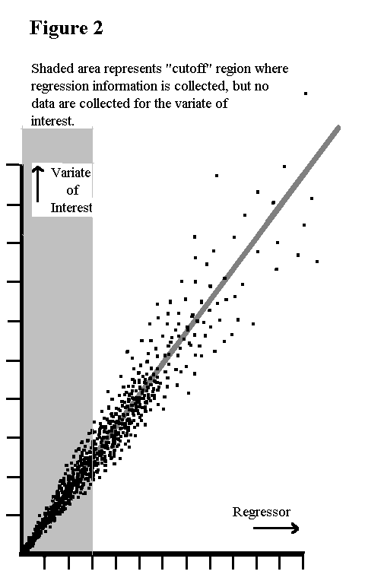
Estimation for Cut-off Sampling
Model-based approach – modeling the excluded elements (Knaub, 2007)

Slide 18
How do we Select the Cut-off Point?
90 percent coverage of attributes
Cumulative Square Root of Frequency (CSRF) method (Dalenius and Hodges, 1957)
Modified Geometric method (Gunning and Horgan, 2004)
Turning points determined by means of a genetic algorithm (Barth and Cheng, 2010)

Slide 19
Modified Cut-off Sampling
Major Concern:
Model may not fit well for the unobserved data
Proposal:
Second sample taken from among those excluded by the cutoff
Alternative sample method based on current stratified probability proportional to size sample design
19

Slide 20
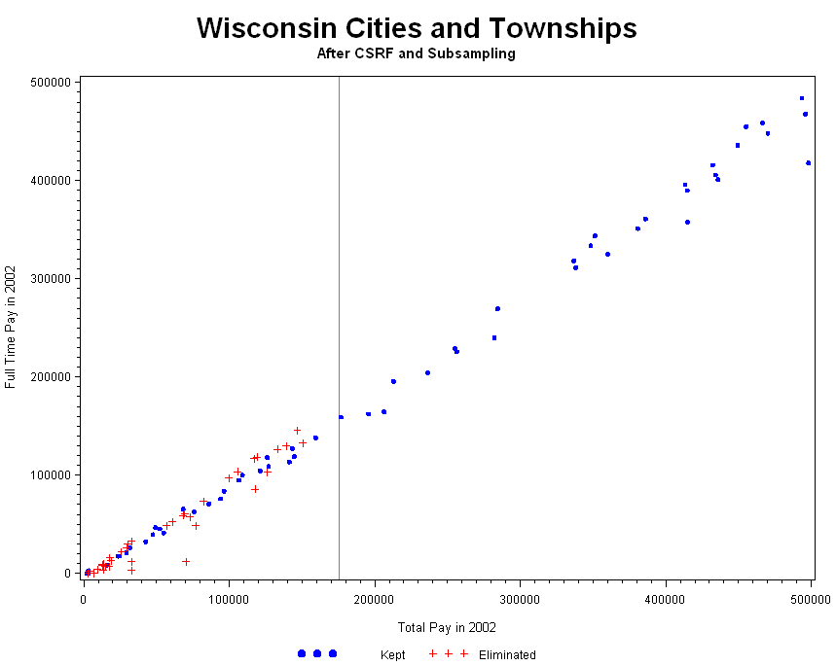
20

Slide 21
Key Variables for Employment Survey
The size variable used in PPS sampling is
Z=TOTAL PAY from the 2007 Census
The survey response attributes Y:
  Full-time Employment
  Full-time Pay
  Part-Time Employment
  Part-Time Pay
The regression predictor X is the same variable as Y from the 2007 Census
21

Slide 22
Modified Cut-off Sample Design
Two-stage approach:
First stage: Select a stratified PPS based on Total Pay
Second stage: Construct the cut-off point to distinguish small and large size units for special districts and for cities and townships (sub-counties) with some conditions
22

Slide 23
Notation
S = Overall sample
S₁= Small stratum sample
n₁ = Sample size of S₁
S₂ = Large stratum sample
n₂ = Sample size of S₂
c = Cut-off point between S₁ and S₂
p = Percent of reduction in S₁
S₁* = Sub-sample of S₁
n₁* = pn₁
23

Slide 24
Modified Cutoff Sample Method
24
Lemma 1:
Let S be a probability proportional to size (PPS) sample with sample size n drawn from universe U with known size N. Suppose is selected by simple random sampling, choosing m out of n. Then, is a PPS sample.

Slide 25
How do we Select the Parameters of Modified Cut-off Sampling?
Cumulative Square Root Frequency for reducing samples (Barth, Cheng, and Hogue, 2009)
Optimum on the mean square error with a penalty cost function (Corcoran and Cheng, 2010)

Slide 26
Model Assisted Approach
Modified cut-off sample is stratified PPS sample
    50 States and Washington, DC
    4-6 modified governmental types: Counties, Sub-Counties (small, large), Special Districts (small, large), and School Districts
A simple linear regression model:
Where
26

Slide 27
Model Assisted Approach (continued)
For fixed g and h, the least square estimate of the linear regression coefficient is:
where and
Assisted by the sample design, we replaced by
27

Slide 28
Model Assisted Approach (continued)
Model assisted estimator or weighted regression (GREG) estimator is
where , , and
28

Slide 29
Decision-based Approach
Idea: Test the equality of the model parameters to determine whether we combine data in different strata in order to improve the precision of estimates.
Analyze data using resulting stratified design with a linear regression estimator (using the previous Census value as a predictor) within each stratum (Cheng, Corcoran, Barth, and Hogue, 2009)
29
29

Slide 30
Decision-based Approach
Lemma 2:
When we fit 2 linear models for 2 separate data sets, if and , then the variance of the coefficient estimates is smaller for the combined model fit than for two separate stratum models when the combined model is correct.
Test the equality of regression lines
Slopes
Elevation (y-intercepts)
30
30

Slide 31
Test of Equal Slopes (Zar, 1999)
where
and
31
31

Slide 32
Test of Equal Elevation
where
32
32

Slide 33
More than Two Regression Lines
If rejected, k-1 multiple comparisons are possible.
33
33

Slide 34
Test of Null Hypothesis
Data analysis: Null hypothesis of equality of intercepts cannot be rejected if null hypothesis of equality of slopes cannot be rejected.
The model-assisted slope estimator, , can be expressed within each stratum using the PPS design weights as
where

Slide 35
Test of Null Hypothesis (continued)
In large samples, is approximately normally distributed with mean b and a theoretical variance denoted .
The test statistic becomes
If the P value is less than 0.05, we reject the null hypothesis and conclude that the regression slopes are significantly different.
where

Slide 36

Decision-based Estimation
Null hypothesis:
The decision-based estimator:
If reject H₀
If cannot reject H₀
36
36

Slide 37
37
37

Slide 38
38
38

Slide 39
Test results for decision-based method
 | FT_Pay |  | FT_Emp |  | PT_Pay
(State,Type) | Test-Stat | Decision | Test-Stat | Decision | Test-Stat | Decision
(AL, SubCounty) | 2.06 | Reject | 2.04 | Reject | 3.62 | Reject
(CA, SpecDist) | 0.98 | Accept | 1.02 | Accept | 0.29 | Accept
(PA, SubCounty) | 0.54 | Accept | 0.62 | Accept | 0.08 | Accept
(PA, SpecDist) | 0.24 | Accept | 0.65 | Accept | 1.09 | Accept
(WI, SubCounty) | 0.57 | Accept | 0.85 | Accept | 2.11 | Reject
(WI, SpecDist) | 1.33 | Accept | 0.85 | Accept | 2.52 | Reject

Slide 40
Small Area Challenge
Our sample design is at the government unit level
Estimating the total employees and payroll in the annual survey of public employment and payroll
Estimating the employment information at the functional level.
    There are 25-30 functions for each government unit
    Domain for functional level is subset of universe U
    Sample size for function f, and
Estimate the total of employees and payroll at state by function level:
40

Slide 41
Functional Codes
001, Airports
002, Space Research & Technology (Federal)
005, Correction
006, National Defense and International Relations (Federal)
012, Elementary and Secondary - Instruction
112, Elementary and Secondary - Other Total
014, Postal Service (Federal)
016, Higher Education - Other
018, Higher Education - Instructional
021, Other Education (State)
022, Social Insurance Administration (State)
023, Financial Administration
024, Firefighters
124, Fire - Other
025, Judical & Legal
029, Other Government Administration
032, Health
001, Airports
040, Hospitals
044, Streets & Highways
050, Housing & Community Development (Local)
052, Local Libraries
059, Natural Resources
061, Parks & Recreation
062, Police Protection - Officers
162, Police-Other
079, Welfare
080, Sewerage
081, Solid Waste Management
087, Water Transport & Terminals
089, Other & Unallocable
090, Liquor Stores (State)
091, Water Supply
092, Electric Power
093, Gas Supply
094, Transit
040, Hospitals
092, Electric Power
093, Gas Supply
41

Slide 42
Direct Domain Estimates
Structural zeros are cells in which observations are impossible
42

Slide 43
Direct Domain Estimates (continued)
Horvitz-Thompson Estimation
Modified Direct Estimation
43

Slide 44
Synthetic Estimation
Synthetic assumption: small areas have the same characteristics as large areas and there is a valid unbiased estimate for large areas
Advantages:
  Accurate aggregated estimates
  Simple and intuitive
  Applied to all sample design
  Borrow strength from similar small areas
  Provide estimates for areas with no sample from the sample survey
44

Slide 45
Synthetic Estimation (continued)
45
General idea:
Suppose we have a reliable estimate for a large area and this large area covers many small areas. We use this estimate to produce an estimator for small area.
Estimate the proportions of interest among small areas of all states.

Slide 46
Synthetic Estimation (continued)
46
Synthetic estimation is an indirect estimate, which borrows strength from sample units outside the domain.
Create a table with government function level as rows and states as columns. The estimator for function f and state g is:

Slide 47
Synthetic Estimation (continued)
Function Code | _{State} |  |  |  |  | _{Total}
 | ₁ | ₂ | ₃ | … | ₅₀
1 | X_{1,1} | X_{1,2} | X_{1,3} | … | X_{1,50} | X_{1,.}
5 | X_{2,1} | X_{2,2} | X_{2,3} | … | X_{2,50} | X_{2,.}
12 | X_{3,1} | X_{3,2} | X_{3,3} | … | X_{3,50} | X_{3,.}
… | … | … | … | … | …
124 | X_{29,1} | X_{29,2} | X_{29,3} | … | X_{29,50} | X_{29,.}
162 | X_{30,1} | X_{30,2} | X_{30,3} | … | X_{30,50} | X_{30,.}
Total | Y_{.,1} | Y_{.,2} | Y_{.,3} | … | Y_{.,50} | X.,.
47

Slide 48
Synthetic Estimation (continued)
48
Bias of synthetic estimators:
Departure from the assumption can lead to large bias.
Empirical studies have mixed results on the accuracy of synthetic estimators.
The bias cannot be estimated from data.

Slide 49
Composite Estimation
To balance the potential bias of the synthetic estimator against the instability of the design-based direct estimate, we take a weighted average of two estimators.
The composite estimator is:
49

Slide 50
Composite Estimation (continued)
Three methods of choosing
Sample size dependent estimate:
if
otherwise
where delta is subjectively chosen. In practice, we choose delta from 2/3 to 3/2.
Optimal :
James-Stein common weight
50

Slide 51
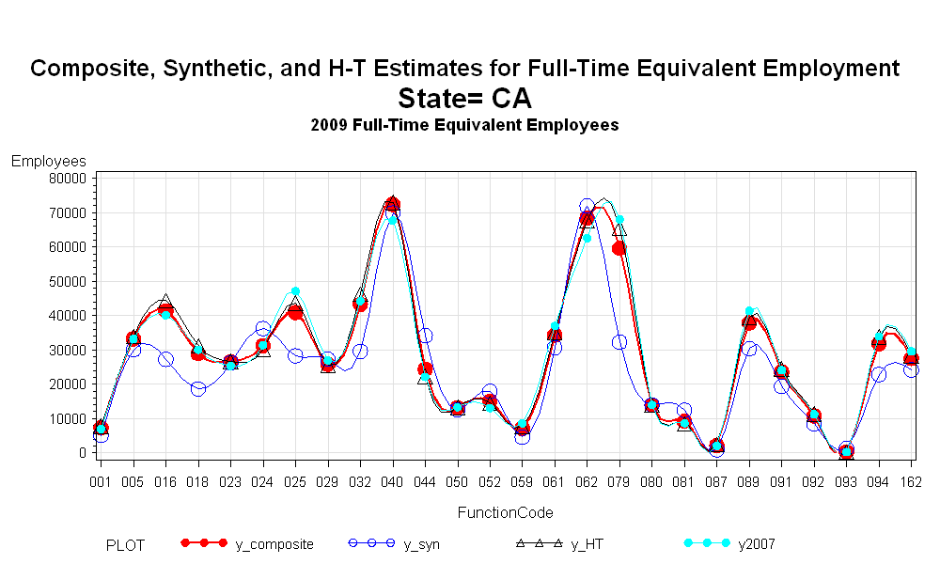
Composite Estimation (Cont’d)
Example

Slide 52
Variance Estimator
To estimate the variance for unequal weights, first apply the Yates-Grundy estimator:
To compensate the variance and avoid the 2nd order joint inclusion probability, we apply the PPSWR variance estimator formula:
where:
and
52

Slide 53

Variance Estimator for Weighted Regression Estimator
The weighted regression estimator:
The naive variance obtained by combining variances for stratum-wise regression estimators and using PPSWR variance formula within each stratum:
where is the single-draw probability of selecting a sample unit i
The variance is estimated by the quantity
53
53

Slide 54
Data Simulation (Cheng, Slud, Hogue 2010)
Regression predictor:
Sample weights:
Response attribute:
54
54

Slide 55
Data Simulation Parameters Table
Examples | a | b | c | D | σ1 | σ2 | n1 | n2 | N1 | N2
1 | 0 | 2 | 0.2 | 0 | 3 | 3 | 40 | 60 | 1,500 | 1,200
2 | 0 | 2 | 0 | 0.2 | 3 | 3 | 40 | 60 | 1,500 | 1,200
3 | 0 | 2 | 0 | 0.4 | 3 | 3 | 40 | 60 | 1,500 | 1,200
4 | 0 | 2 | 0 | 0.6 | 3 | 3 | 40 | 60 | 1,500 | 1,200
5 | 0 | 2 | 0 | 0.6 | 4 | 4 | 40 | 60 | 1,500 | 1,200
6 | 0 | 2 | 0 | 0.8 | 4 | 4 | 40 | 60 | 1,500 | 1,200
7 | 0 | 2 | -0.1 | 0.8 | 4 | 4 | 40 | 60 | 1,500 | 1,200
8 | 0 | 2 | 0.2 | 0 | 3 | 3 | 20 | 30 | 1,500 | 1,200

Slide 56








Bootstrap Approach
Population frame: and
Substratum values: ,
Sample selection: PPSWOR with , elements
Bootstrap replications: b=1,...,B
Bootstrap sample: SRSWR with size and
Estimation: Decision-based method was applied to each bootstrap sample
Results: and
56
56

Slide 57


Monte Carlo Approach
The simulated frame populations are the same ones used in the bootstrap simulations.
Monte Carlo replications: r = 1,2...,R
Following bootstrap steps 3, 5, 6, and 7, we have results: and
57
57

Slide 58
Null hypothesis reject rates for decision-based methods
Prej_MC: proportion of rejections in the hypothesis test for equality of slopes in MC method
Prej_Boot: proportion of rejections in the hypothesis test for equality of slopes in Bootstrap method
58

Slide 59
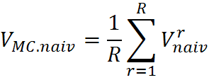
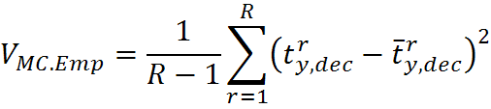

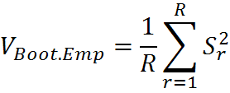


Different Variance Estimators
MC.Naiv:
MC.Emp
Boot.Naiv:
Boot.Emp
where is the sample variance of
59
59

Slide 60
Data Simulation with R=500 and B=60
Examples | Prej. MC | Prej. Boot | MC. Emp | MC. Naiv | Boot. Emp | Boot. Naiv | DEC. MSE | 2str. MSE
1 | 0.796 | 0.719 | 991.8 | 867.9 | 863.6 | 846.9 | 832,904 | 819,736
2 | 0.098 | 0.231 | 920.6 | 873.2 | 871.4 | 856.4 | 846,843 | 857,654
3 | 0.126 | 0.277 | 908.3 | 868.6 | 903.2 | 847 | 826,142 | 845,332
4 | 0.258 | 0.333 | 880.9 | 874.7 | 862.8 | 850.6 | 777,871 | 779,790
5 | 0.144 | 0.249 | 1,159.5 | 1,139 | 1,192.1 | 1111.4 | 1,346,545 | 1,351,290
6 | 0.258 | 0.339 | 1,173.5 | 1,144.1 | 1,179.1 | 1113.7 | 1,374,466 | 1,401,604
7 | 0.088 | 0.217 | 1,167.7 | 1,148.4 | 1,165.3 | 1126.7 | 1,361,384 | 1,397,779
8 | 0.582 | 0.601 | 1,288.2 | 1,209.1 | 1,229.4 | 1149.8 | 1,656,195 | 1,656,324

Slide 61
Monte Carlo & Bootstrap Results
The tentative conclusions from simulation study:
Bootstrap estimate of the probability of rejecting the null hypothesis of equal substratum slopes can be quite different from the true probability
Naïve estimator of standard error of the decision-based estimator is generally slightly less than the actual standard error
Bootstrap estimator of standard error is not reliably close to the true standard error (the MC.Emp column)
Mean-squared error for the decision-based estimator is generally only slightly less than that for the two-substratum estimator, but does seem to be a few percent better for a broad range of parameter combinations.
61
61

Slide 62
References
Barth, J., Cheng, Y. (2010). Stratification of a Sampling Frame with Auxiliary Data into Piecewise Linear Segments by Means of a Genetic Algorithm, JSM Proceedings.
Barth, J., Cheng, Y., Hogue, C. (2009). Reducing the Public Employment Survey Sample Size, JSM Proceedings.
Cheng, Y., Corcoran, C., Barth, J., Hogue, C. (2009). An Estimation Procedure for the New Public Employment Survey, JSM Proceedings.
Cheng, Y., Slud, E., Hogue, C. (2010). Variance Estimation for Decision-Based Estimators with Application to the Annual Survey of Public Employment and, JSM Proceedings.
Clark, K., Kinyon, D. (2007). Can We Continue to Exclude Small Single-establishment Businesses from Data Collection in the Annual Retail Trade Survey and the Service Annual Survey? [PowerPoint slides]. Retrieved from http://www.amstat.org/meetings/ices/2007/presentations/Session8/Clark_Kinyon.ppt
62
62

Slide 63
References
Corcoran, C., Cheng, Y. (2010). Alternative Sample Approach for the Annual Survey of Public Employment and Payroll, JSM Proceedings.
Dalenius, T., Hodges, J. (1957). The Choice of Stratification Points. Skandinavisk Aktuarietidskrift.
Gunning, P., Horgan, J. (2004). A New Algorithm for the Construction of Stratum Boundaries in Skewed Populations, Survey Methodology, 30(2), 159-166.
Knaub, J. R. (2007). Cutoff Sampling and Inference, InterStat.
Sarndal, C., Swensson, B., Wretman, J. (2003). Model Assisted Survey Sampling. Springer.
Zar, J. H. (1999). Biostatistical Analysis. Third Edition. New Jersey, Prentice-Hal
63
63

