Slide 1

Sparse controls for groups on the move
KI-Net Workshop
“Kinetic description of social dynamics:
from consensus to flocking”
CSCAMM, College Park, MA, Nov 2012
Benedetto Piccoli
Joseph and Loretta Lopez Chair Professor of Mathematics
Department of Mathematical Sciences and
Program Director
Center for Computational and Integrative Biology
Rutgers University - Camden

Slide 2
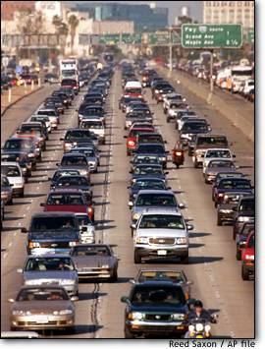
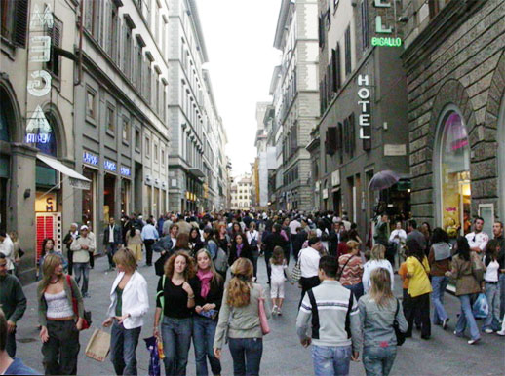
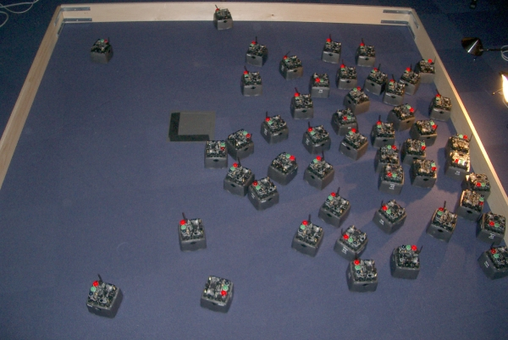
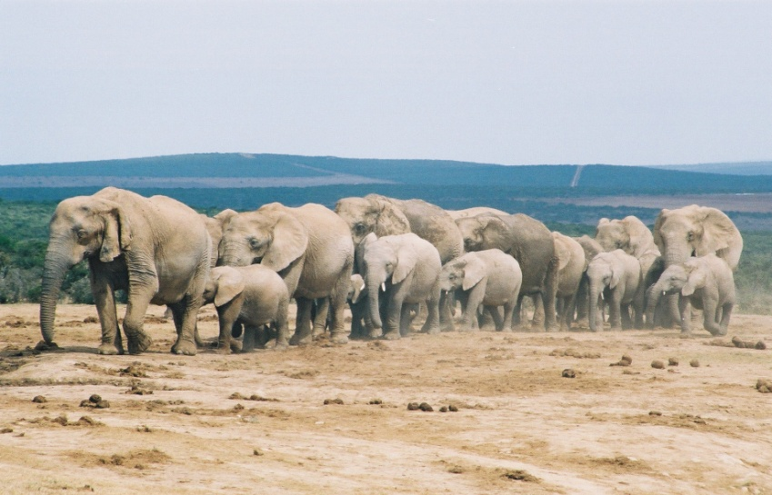
Group of intelligent agents on the move
Autonomous, Self-propelled, Self-driven, Selfish, Greedy, Boids, …
Vehicular traffic
Crowd dynamics
Networked robots
Animal groups

Slide 3
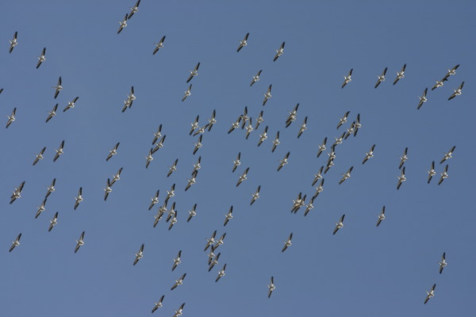
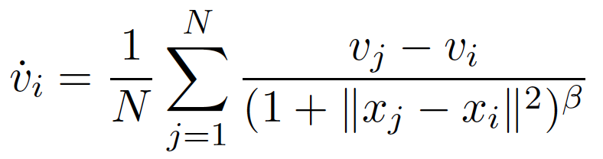

The Cucker and Smale model
Consensus (Flocking)
Cucker-Smale : consensus (flocking) conditions for β>1/2
Ha-Tadmor: hydrodinamic limit of CS
Motsch-Tadmor: local interactions, asymmetric
Particle systems: Reynolds, Vicsek, Ben-Jacob et al, Krause, Couzin, Helbing, …
Degond, Motsch, Carrillo, Fornasier, Toscani, Figalli, …

Slide 4
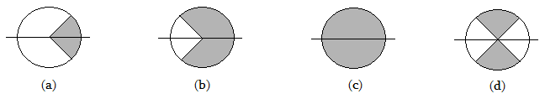
Microscopic for animal groups
Frasca, P., Tosin
Coesion
Repulsion
Visual field
Logic variables activating the forces: discrete and continuous variables
Notes:
4

Slide 5

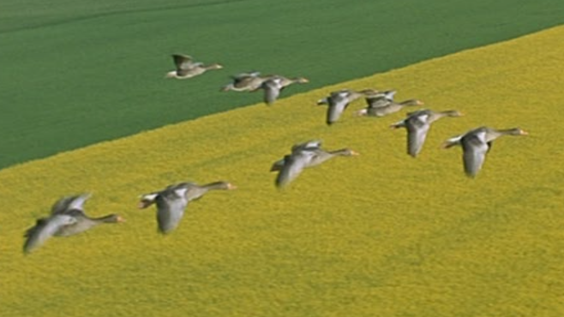
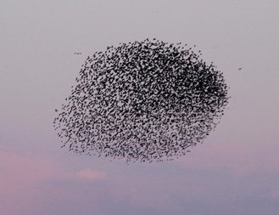
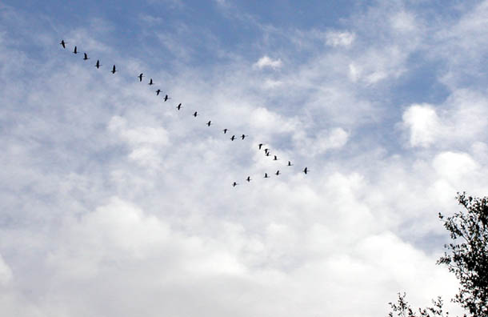
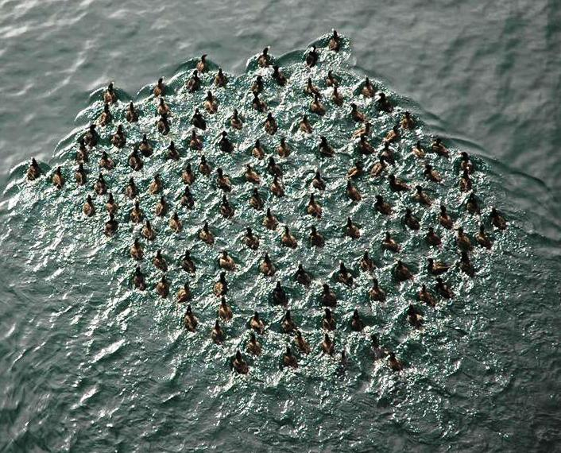
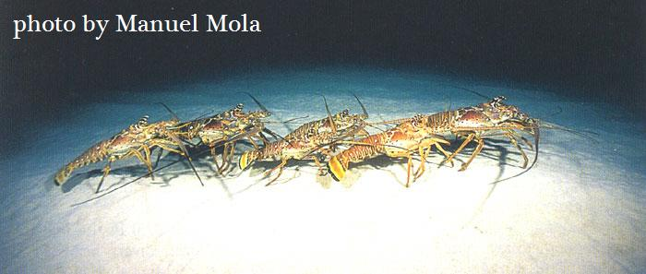
Microscopic for animal groups
R>>C, total vision
C>>R, front vision
C=R, front repulsion
Notes:
5

Slide 6
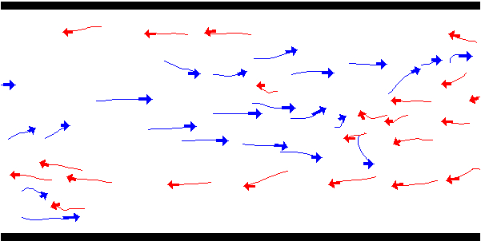

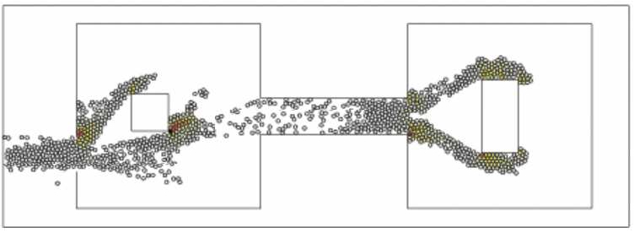
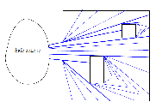


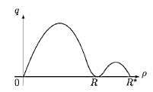
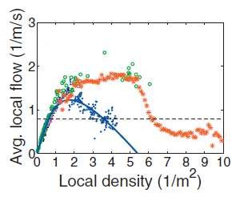
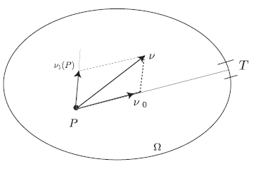
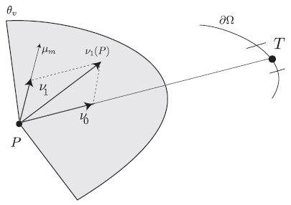


Tens, hundreds, thousands of pedestrians
Helbing et al., microscopic
Maury-Venel, microscopic
Colombo-Rosini, macroscopic 1D
Bellomo-Dogbé, macroscopic

Slide 7






Time evolving measures
Measure μ: (t,E) → μ(t,E) number of pedestrians in the region E
Flow map ɣ: x → x + v(x,μ) Δt move points with given velocity
At next time step is given by μ(t+Δt ,E) = μ(t,ɣ⁻¹ (E))
The velocity v is the sum of desired velocity v
d
and interaction term v (μ)
i
E
ɣ⁻¹ (E)
ɣ⁻¹
v
d
E
ɣ
v (μ)
i
Time evolving measares: Canuto-Fagnani-Tilli, Tosin-P., Muntean et al.,
Santambrogio, Carrillo-Figalli et al., Colombo, Gwiazda ….

Slide 8
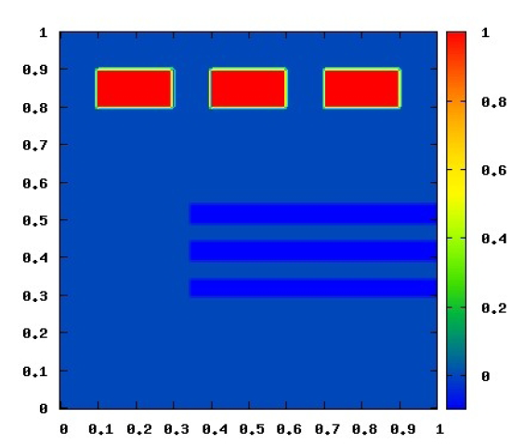
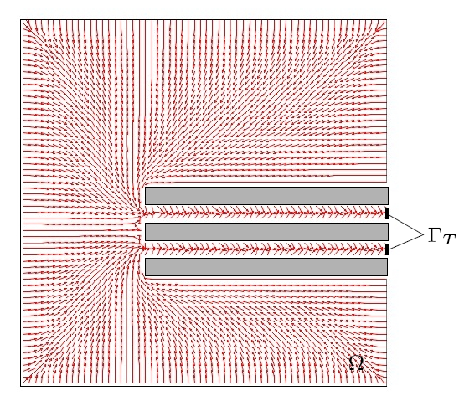
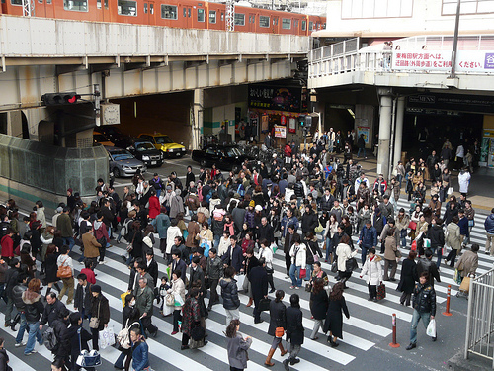
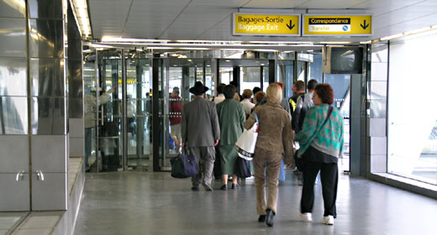
Macroscopic for self-organization in pedestrians
Initial condition
Desired velocity field
Exiting the metro: real movie
Exiting the metro: simulation
MICRO
MULTISCALE
MACRO

Slide 9
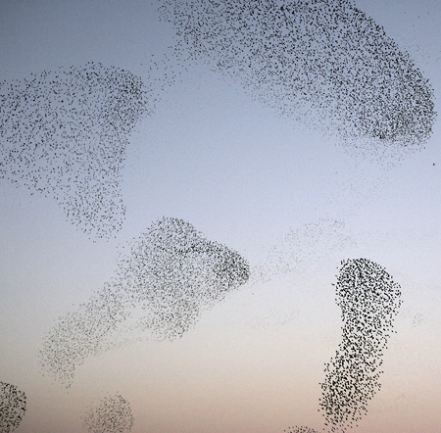
Beyond Consensus
Case study : Cucker-Smale model
+u_{i}
Control of Cucker-Smale: Caponigro, Fornasier, P., Trelat
Non-Flocking
Organization via intervention
Flocking

Slide 10
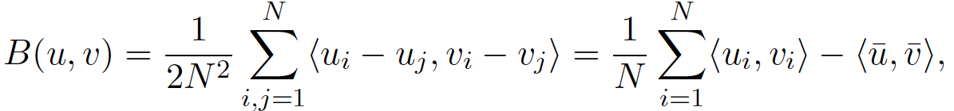
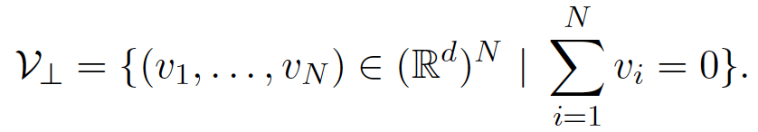
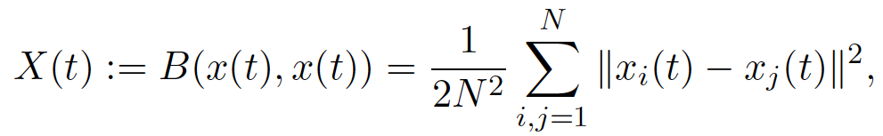
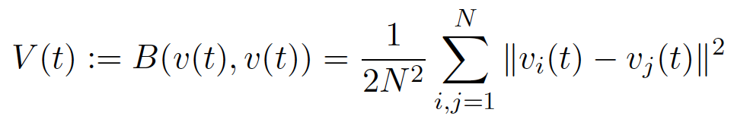
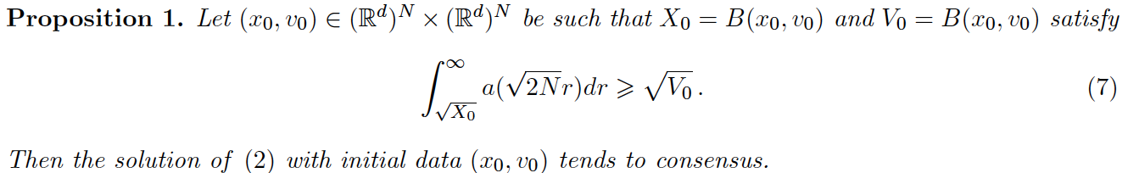
Technical details (1)

Slide 11
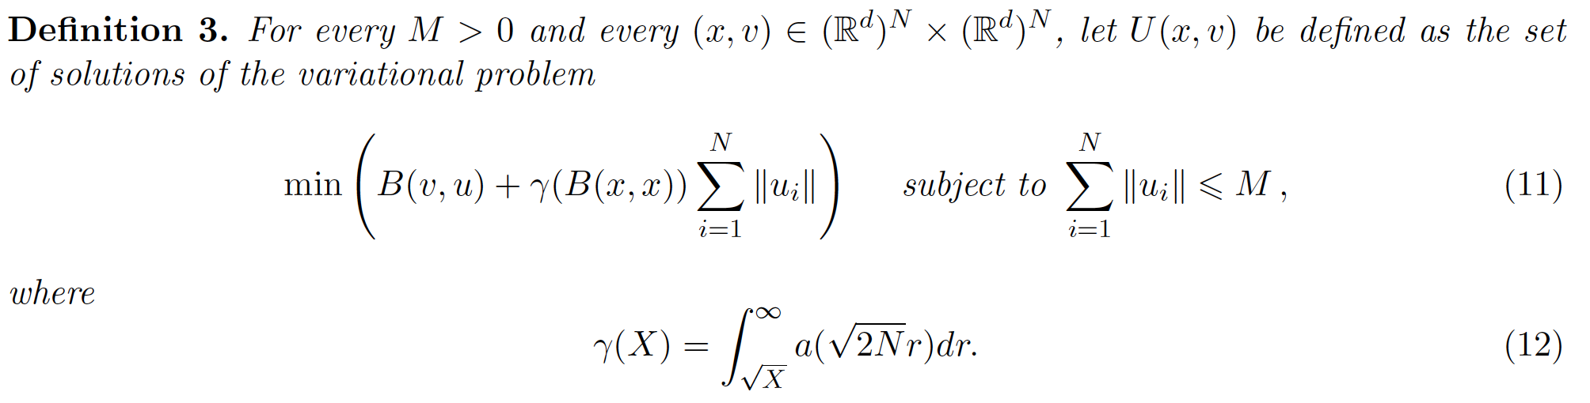
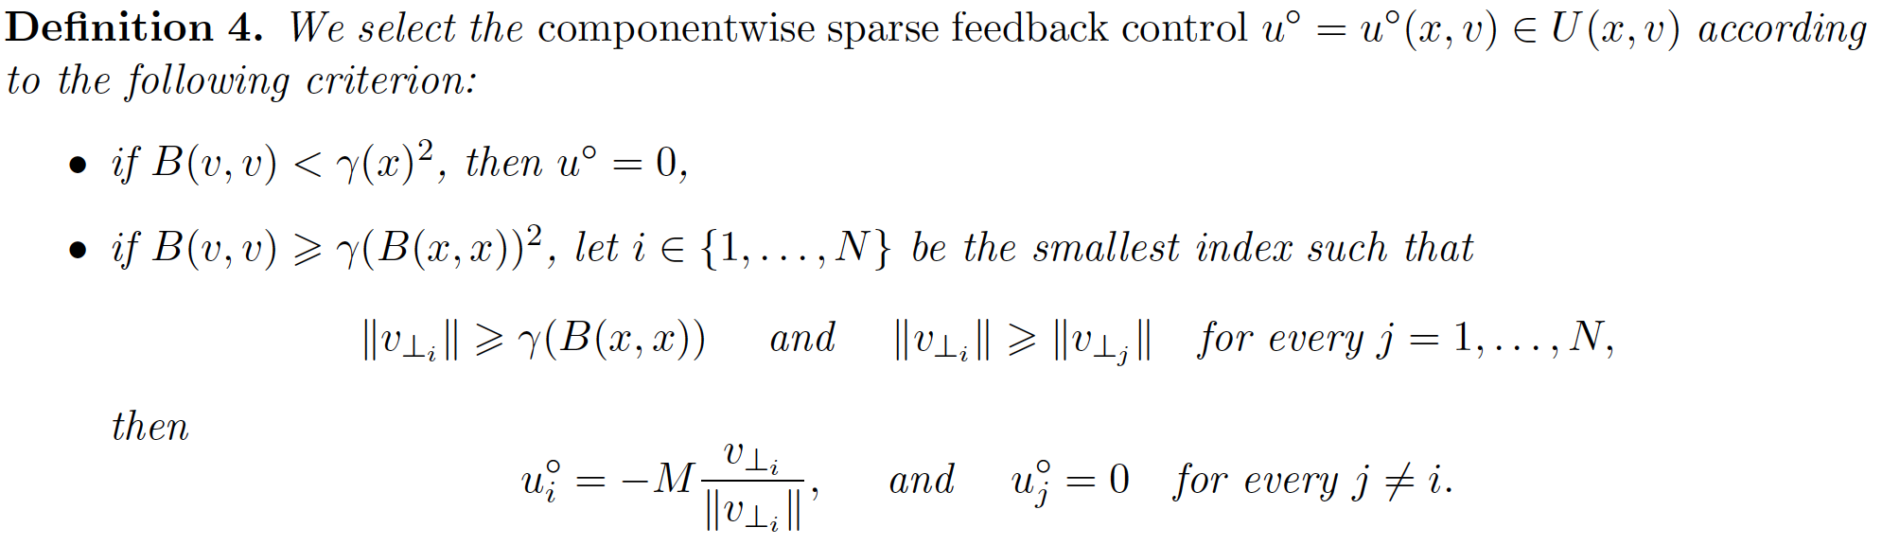
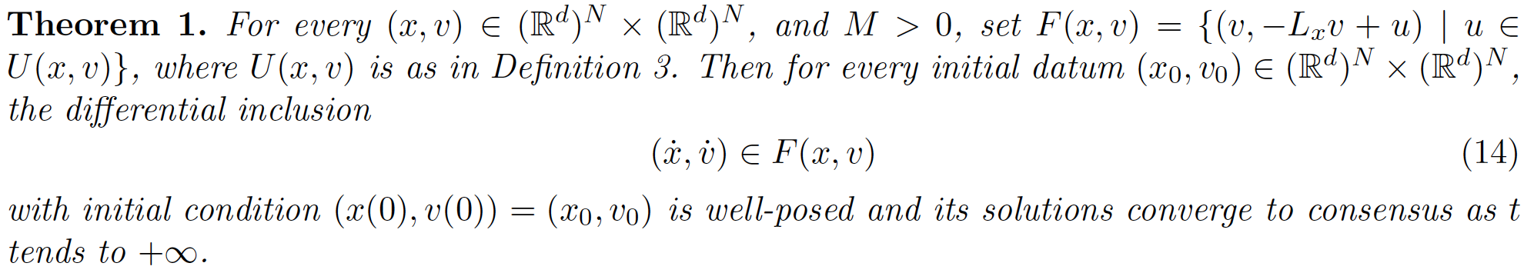
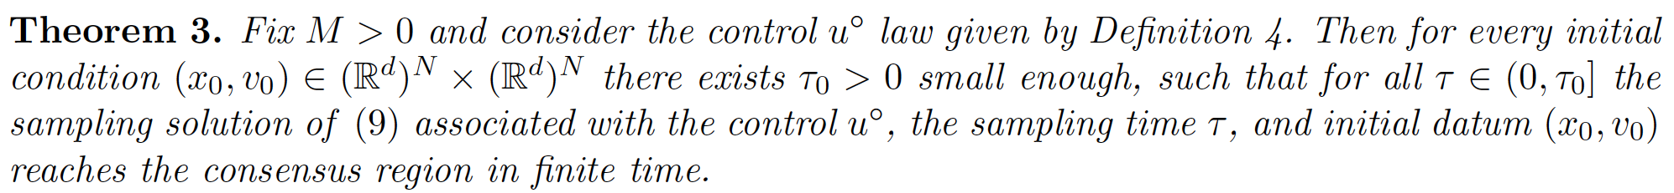
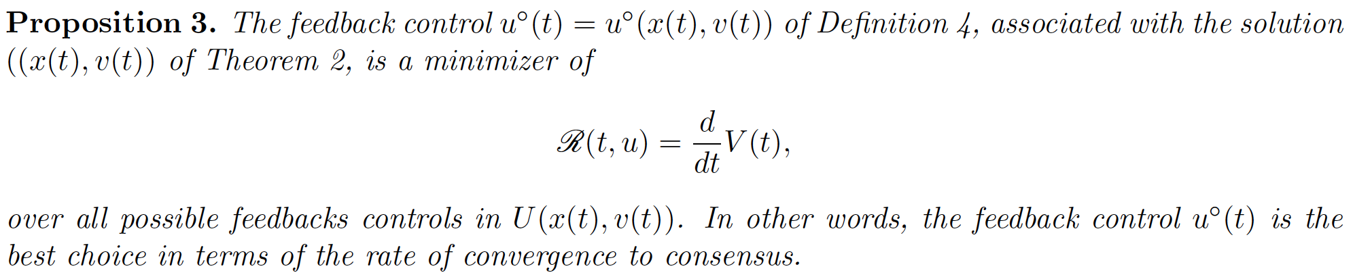
Technical details (2)

Slide 12
Simulation results
Modulus of the velocities
Positions in the space
Movie 1
Movie 2
Movie 3
Movie 4
Movie 5
Movie 6

Slide 13
Summary of results for control of CS
Stabilizing controls to consensus using all agents
Well posed differential inclusion using l1 functional for sparsity
Componentwise sparse controls
Timewise sparse controls using sampling
Clarke-Ledyaev-Sontag-Subbotin solutions
Sparse is better principle
Controllability to and on consensus manifold
Optimal control is sparse with positive codimension

Slide 14
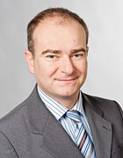
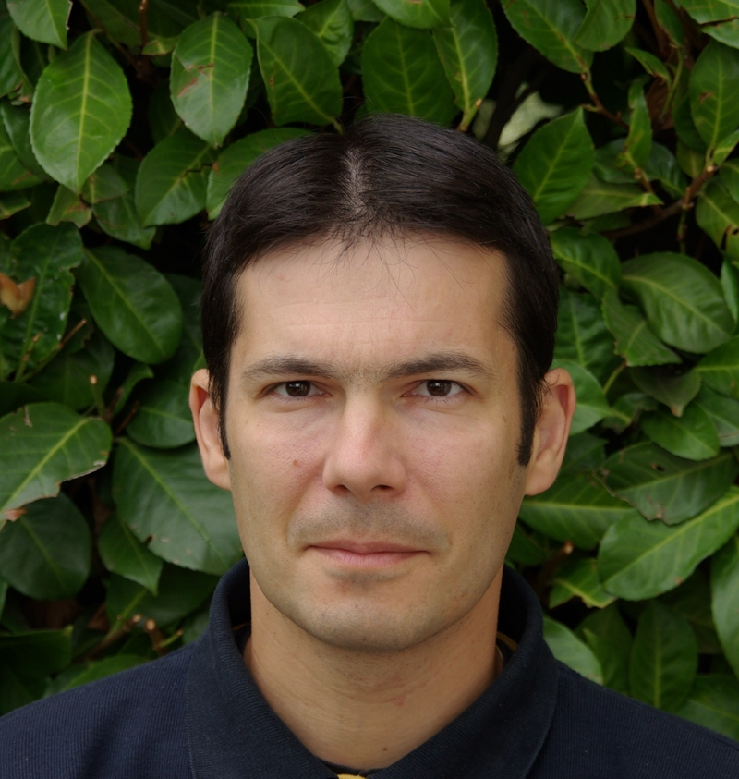

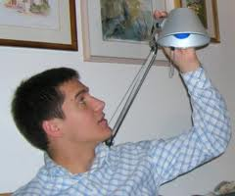
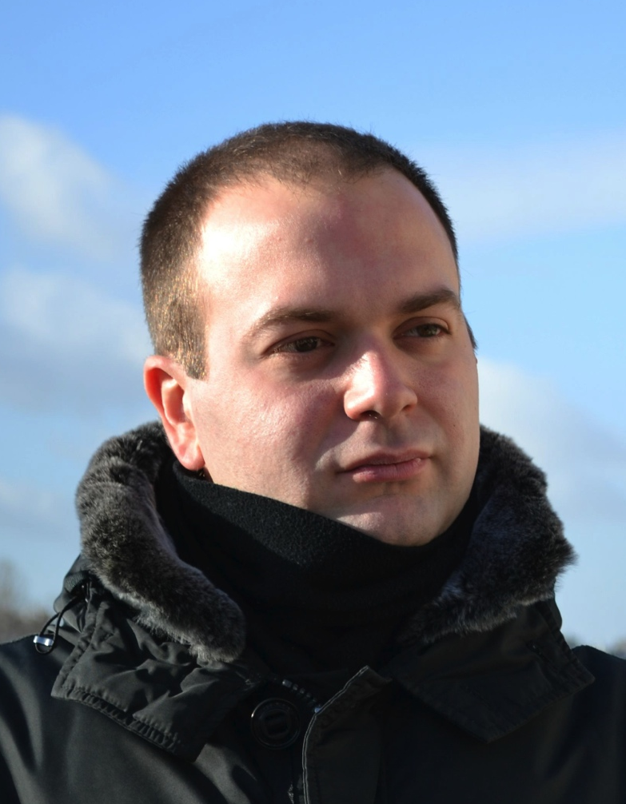
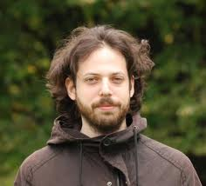
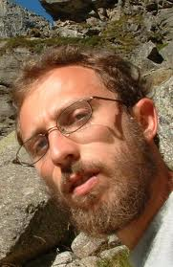
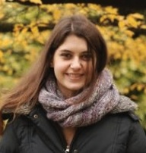
CROWD DYNAMICS
CONTROL OF CS
Massimo Fornasier
Emmanuel Trelat
Andrea Tosin
Francesco Rossi
Marco Caponigro
SOCIAL
Emiliano Cristiani
Paolo Frasca
Anna Chiara Lai
ANIMAL GROUPS

Slide 15

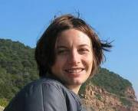
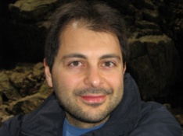
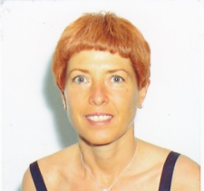
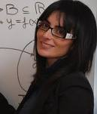
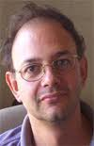
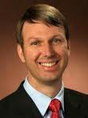



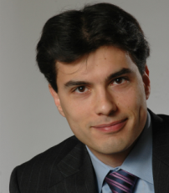

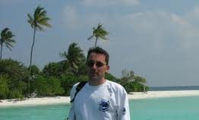
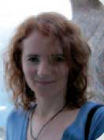





CROWD DYNAMICS
VEHICULAR TRAFFIC
SUPPLY CHAINS
SOCIAL
Simone Goettlich
Francesco Rossi
Mauro Garavello
Paola Goatin
Alessia Marigo
Andrea Tosin
Gabriella Bretti
Anna Chiara Lai
Roberto Natalini
Dirk Helbing
Dan Work
Ciro D’Apice
Michael Herty
Emiliano Cristiani
Seb Blandin
Alex Bayen
Corrado Lattanzio
Marco Caponigro
Rosanna Manzo
Giuseppe Coclite
Amelio Maurizi
Yacine Chitour
Paolo Frasca
Rinaldo Colombo
ANIMAL GROUPS
Axel Klar

Slide 16
Collaborators
Marco Caponigro
Massimo Fornasier
Emmanuel Trelat
Emiliano Cristiani
Paolo Frasca

Slide 17
Opinion Formation
Krause on the N-sphere
Equilibria
Rendez-vous
Antipodal
Polygonal

Slide 18
Opinion formation
Symmetric interaction
Equilibrium exponentially fast
Non-symmetric interaction
Periodic Orbits, Chaotic dynamics
External action:
Media, opinion leaders, influencers,
15 opinions
low action
150 opinions
low action
15 opinions
symmetric
150 opinions
symmetric
15 opinions
non-symmetric
Opinion formation: various, Caponigro-Lai-P.

Slide 19
Thank you for your attention!
G. Bastin, A. Bayen, C. D'Apice, X. Litrico, B. Piccoli, Open problems and research perspectives for irrigation channels, Networks and Heterogeneous Media, 4 (2009), i-v.
M. Caramia, C. D'Apice, B. Piccoli and A. Sgalambr, Fluidsim: a car traffic simulation prototype based on fluid dynamic, Algorithms, 3 (2010), 291-310.
A. Cascone, C. D’Apice, B. Piccoli and L. Rarità, Optimization of traffic on road networks, M3AS Mathematical Methods and Modelling in Applied Sciences 17 (2007), 1587-1617.
G.M. Coclite, M. Garavello and B. Piccoli, Traffic Flow on a Road Network, Siam J. Math. Anal 36 (2005), 1862-1886.
R. Colombo, P. Goatin, B. Piccoli, Road networks with phase transitions, Journal of Hyperbolic Differential Equations 7 (2010), 85-106.
E. Cristiani, C. de Fabritiis, B. Piccoli, A fluid dynamic approach for traffic forecast from mobile sensors data, Communications in Applied and Industrial Mathematics 1 (2010), 54-71.
C. Emiliani, P. Frasca, B. Piccoli, Effects of anisotropic interactions on the structure of animal groups, to appear on Journal of Mathematical Biology.
C. D'Apice, S. Goettlich, M. Herty, B. Piccoli, Modeling, Simulation and Optimization of Supply Chains, SIAM series on Mathematical Modeling and Computation, Philadelphia, PA, 2010.
C. D'Apice, B. Piccoli, Vertex flow models for vehicular traffic on networks, Mathematical Models and Methods in Applied Sciences (M3AS), 18 (2008), 1299 -1315.
M. Garavello and B. Piccoli, Traffic Flow on Networks, AIMS Series on Applied Mathematics, vol. 1, American Institute of Mathematical Sciences, 2006, ISBN-13: 978-1-60133-000-0.
M. Garavello, B. Piccoli, Source-Destination Flow on a Road Network, Communications Mathematical Sciences 3 (2005), 261-283.
M. Garavello, B. Piccoli, Traffic flow on a road network using the Aw-Rascle model, Comm. Partial Differential Equations 31 (2006), 243-275.
M. Garavello, B. Piccoli, On fluid dynamic models for urban traffic , Networks and Heterogeneous Media 4 (2009), 107-126.
M. Garavello, R. Natalini, B. Piccoli and A. Terracina, Conservation laws with discontinuous flux, Network Heterogeneous Media 2 (2007), 159—179.
A. Marigo and B. Piccoli, A fluid-dynamic model for T-junctions, SIAM J. Appl. Math. 39 (2008), 2016-2032.
B. Piccoli, A. Tosin, Pedestrian flows in bounded domains with obstacles, Continuum Mechanics and Thermodynamics 21 (2009), 85-107.
D. Work, S. Blandin, O.-P. Tossavainen, B. Piccoli, A. Bayen, A traffic model for velocity data assimilation, Applied Mathematics Research Express, 2010 (2010), 1-35.

