Slide 1
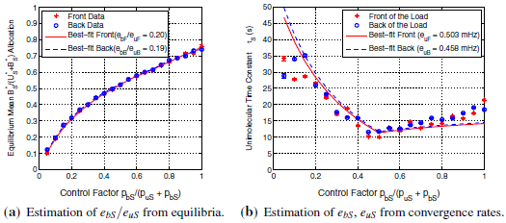
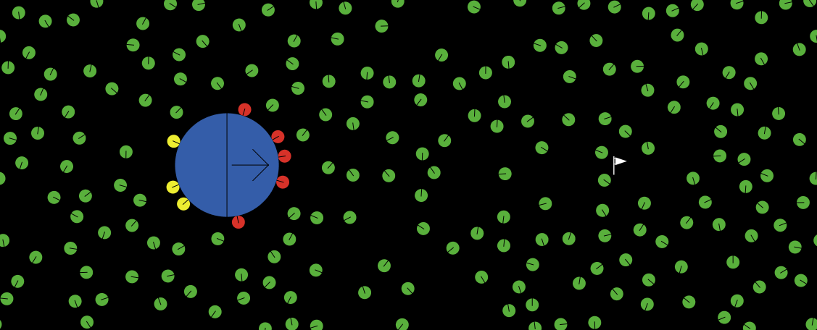
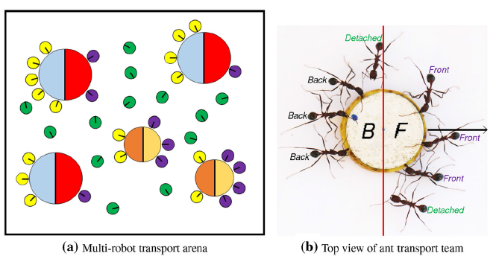
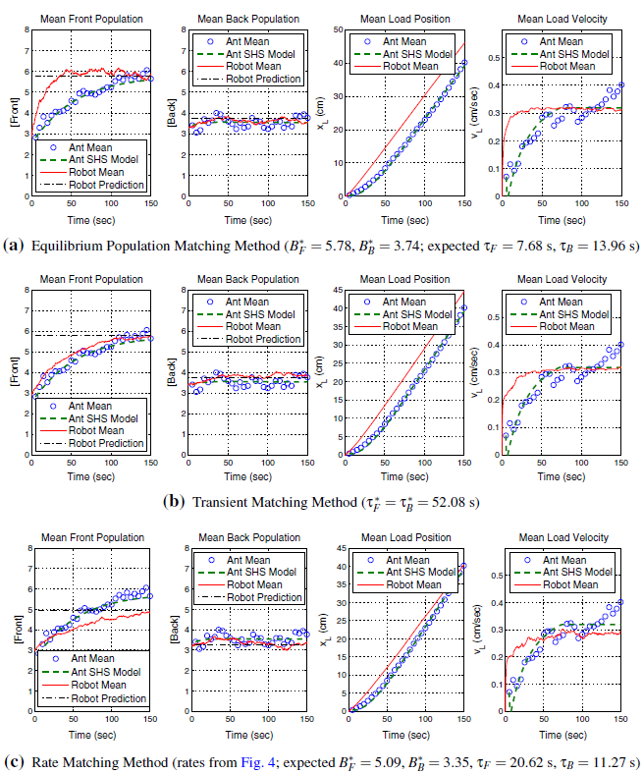
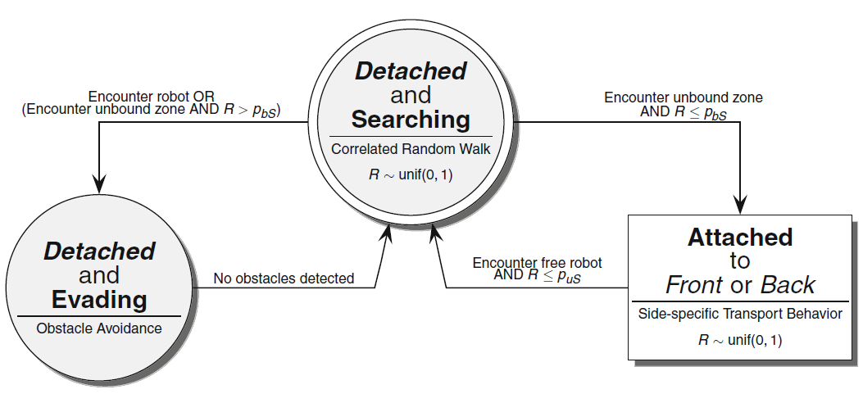
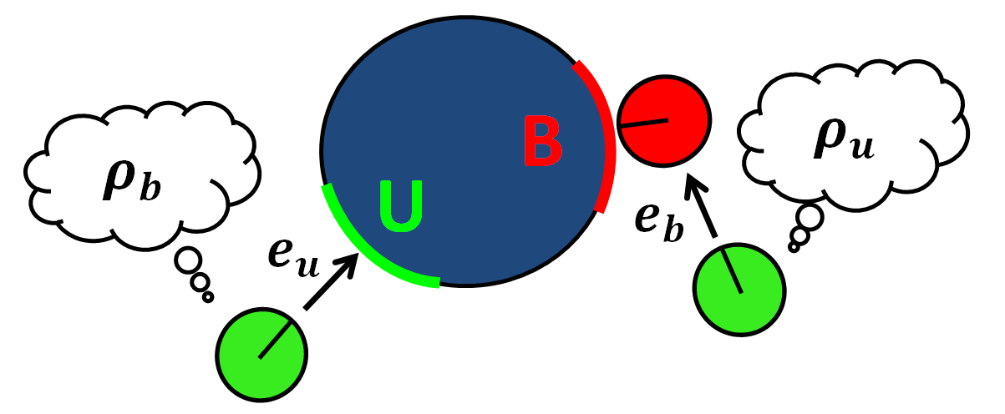
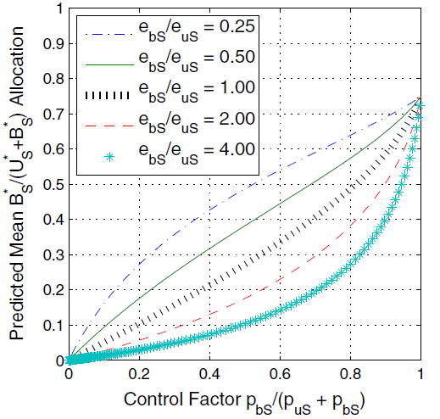
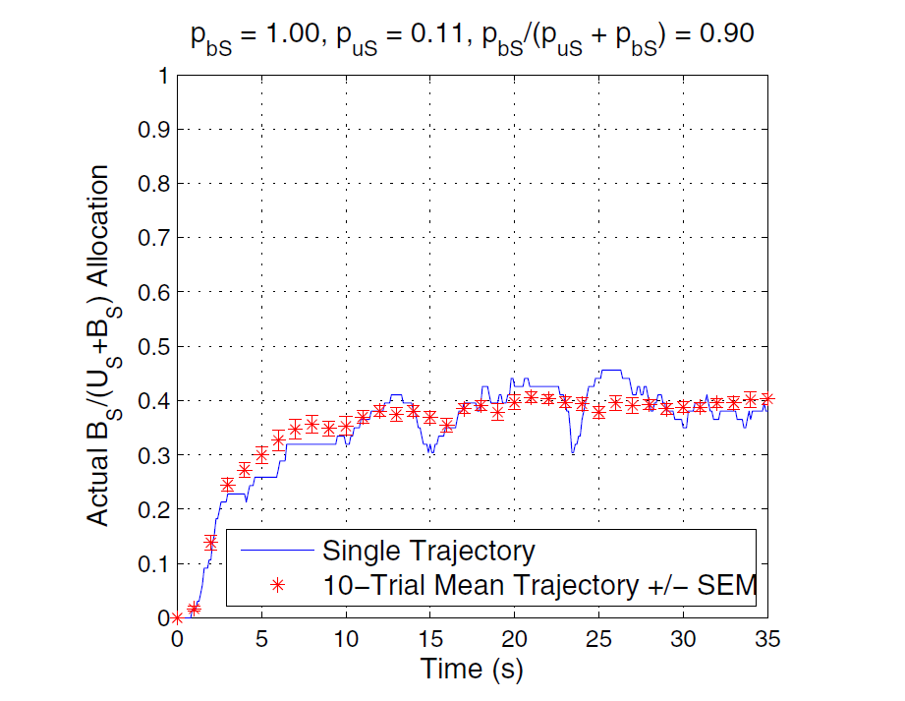
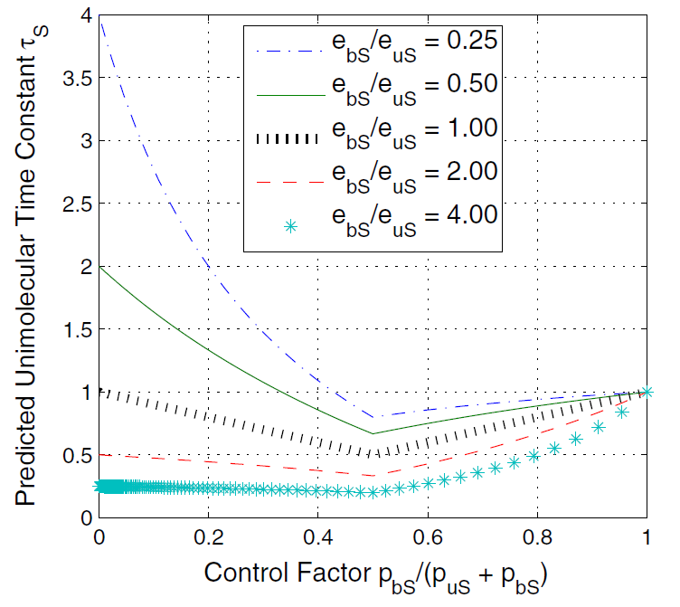
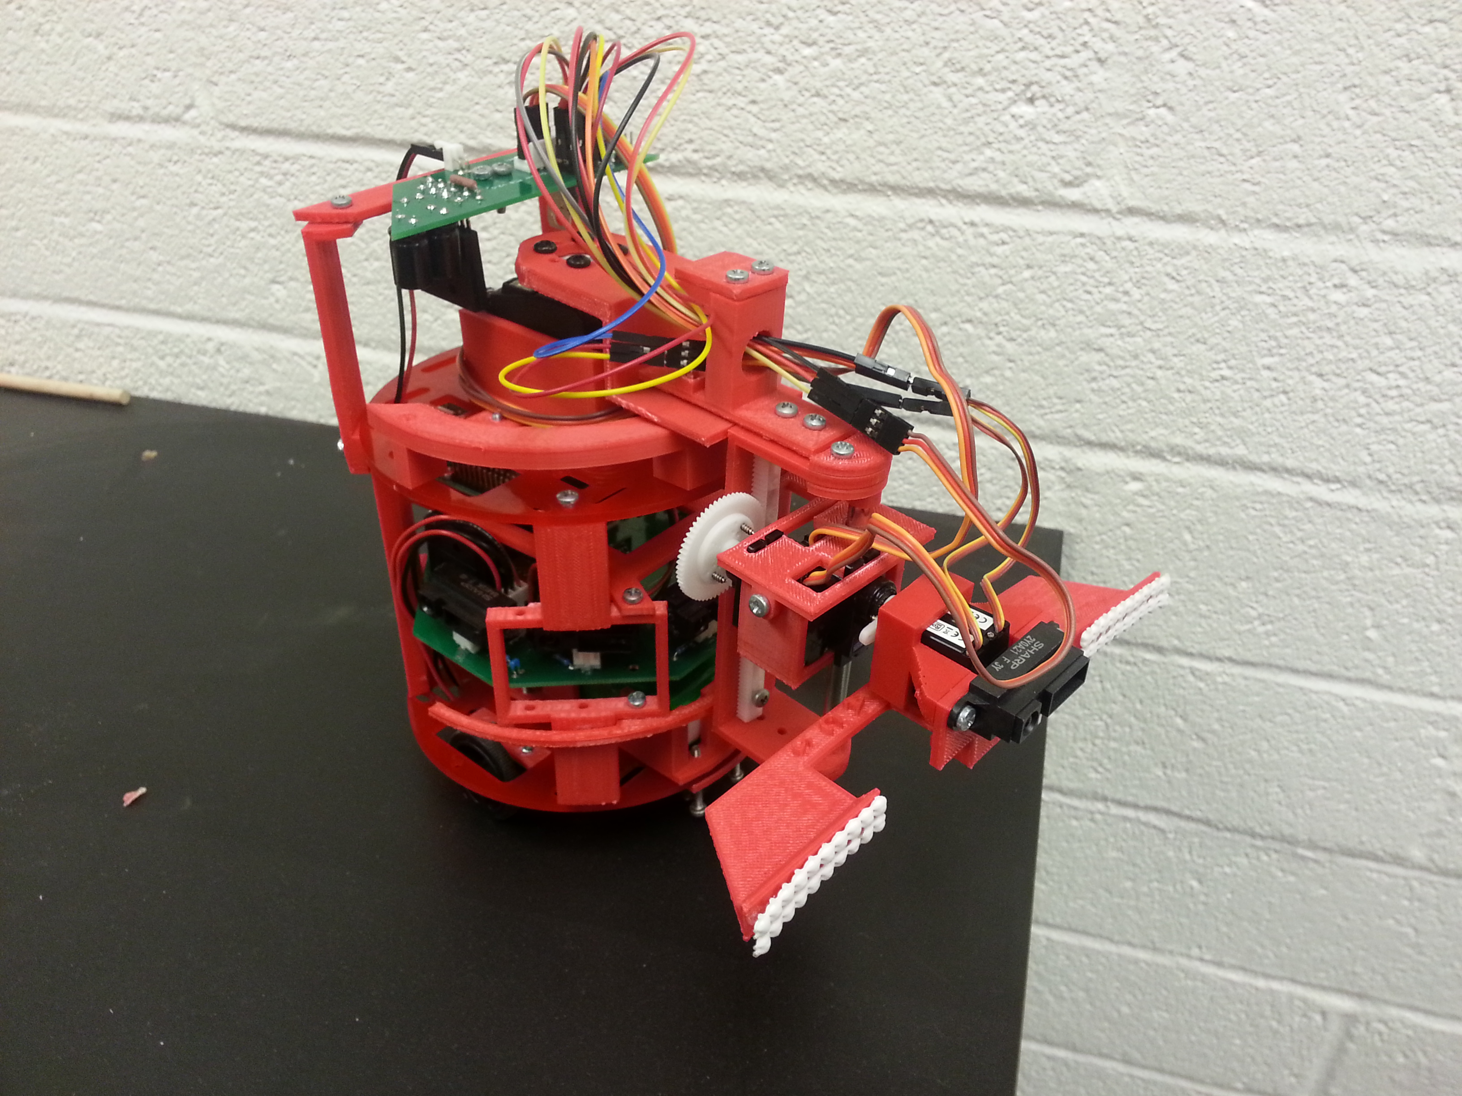
Design of Ant-Inspired Stochastic Control Strategies for Boundary Coverage and Collective Transport by Robotic Swarms
Contribution
Approach
Simulation and Results
A bio-inspired, leaderless, decentralized boundary coverage and cooperative manipulation control scheme is developed for a robotic swarm. This control scheme is validated by mimicking an observed and modeled group transport behavior exhibited by Novomessor cockerelli (Kumar et al. HSCC 2013).
Use a macroscopic population dynamic model to design enzyme-inspired stochastic control policies that allocate a robotic swarm around multiple boundaries. This model is used to synthesize three sets of stochastic robot attachment-detachment policies for tasks where a robot swarm must achieve non-uniform spatial distributions around multiple loads and transport them at a constant velocity.
100 simulations are run for each control design (EPMM, TMM, RMM). For each run, 200 1-cm radius unattached robots, with parameters from the ant experiments, are initialized randomly in a 125 cm x 50 cm environment. A rigid circular load with radius 8 cm and mass 2.3 g is placed in the arena with the robots.
Chemical Reaction Network Model
The notation r + U_{S} represents the event of a free robot (r) encountering an unbound zone on the side S (U_{S}), where S ϵ {Front (F), Back (B)}.
The notation $\underset{→}{p_{bS}e_{uS}}B_{S}$ represents how often such encounter events occur and result in the free robot (r) binding to the unbound zone (U_{S}) to produce a new bound zone $B_{S}$.
Individual Robot Controller
Methods
Estimating Encounter Rates
State-transition diagram of robot controller for collective transport. The diagram outlines a program that would run on a single robot. Here, p_{uS} and p_{bS} are designed probabilities to unbind (detach) and bind (attach) respectively to side S.
Simplified Load Dynamics
(1)
(2)
Controller Synthesis
Equilibrium Population Matching Method (EPMM) : Only requires the encounter rate ratio ($e_{bS}/e_{uS}$) to design the probabilities of attaching and detaching (p_{bS}, p_{uS} ) through Eq. 1. This allows for the fastest convergence time to the equilibrium population states but ignores the transient population dynamics.
Load
Transient Matching Method (TMM) : Requires the absolute encounter rates ($e_{bS}$, $e_{uS}$) from Eqs. 1 and 2 to design the probabilities of attaching and detaching (p_{bS}, p_{uS} ) through Eq. 1. This design converges slower than the EPMM but matches the population transient rise time.
Future Work
Attached to Back
Attached to Front
Validate results on the Pheeno robotic platform.
Rate Matching Method (RMM) : Requires the absolute encounter rates ($e_{bS}$, $e_{uS}$) from Eqs. 1 and 2 to design the probabilities of attaching and detaching (p_{bS}, p_{uS} ). The design equates the rates in two Markov Chain descriptions of the macroscopic model. This design matches fluxes into and out of states but does not allow for matching of equilibrium populations.
Expand analysis to dynamic boundaries.
While attached, robots lift the load to alleviate friction. Robots attached to the front pull with a force according to a proportional velocity controller.
Investigate methods to “turn off” the attachment-detachment process.
Sean Wilson et al. Design of Ant-Inspired Stochastic Control Policies for Collective Transport by Robotic Swarms. Swarm Intelligence, 8(4):303-327, Dec. 2014.
Autonomous Collective Systems Laboratory ACS Lab
Director: Dr. Spring Berman
http://faculty.engineering.asu.edu/acs/

