Slide 1

Localization at the Edge of 2D Topological Insulator by Kondo Impurities
Boris Altshuler
Physics Department, Columbia University
Collaboration:
Vladimir Yudson Institute for Spectroscopy, RAS, Moscow, Russia
Igor Aleiner Physics Department, Columbia University
Mathematical and Physical Aspects of Topologically Protected States
Columbia University
May 1, 2017

Slide 2
2D Topological Insulator
Kane and Mele (2005);
Bernevig, T. L. Hughes, and S. C. Zhang (2006) CdTe-HgTe-CdTe
In the balk (inside the plane) – gap in the spectrum of charge excitations insulator
At the edge excitations are gapless 1D metal
Insensitive to any static disorder – topological protection.

Slide 4


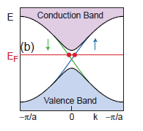
2D Topological Insulator
Kane and Mele (2005);
Bernevig, T. L. Hughes, and S. C. Zhang (2006) CdTe-HgTe-CdTe
Hamiltonian of the chiral states at the helical edge
momentum
Fermi velocity
Z-component of the spin
Note: need strong spin-orbital interaction

Slide 5
Electric field
Rashba term:

Slide 6
2D Topological Insulator
Kane and Mele (2005);
Bernevig, T. L. Hughes, and S. C. Zhang (2006) CdTe-HgTe-CdTe
Hamiltonian of the chiral edge states
momentum
Fermi velocity
Z-component of the spin
Chiral edge states:
Left and Right movers

Slide 7
1d localization
Even a “weak” disorder is not weak in d=1 !
Mott and Twose (1961):
M. E. Gertsenstein and V. B. Vasiliev, “Wave guides with random inhomogeneities and Brownian motion in the Lobachevsky plane”, Theory of Probability & Its Applications, 1959, Vol. 4, No. 4 : pp. 391-398
Exact Solution!
Localization length ~ mean free path
Consequence: zero DC conductivity
Why all this is not directly applicable to 1D helical edge electrons?

Slide 8
Chiral edge states:
Left and Right movers
Backscattering would mix the chiral states and thus destroy chirality.
One needs spin-flip for the backscattering.
Kramers degeneracy: one needs to violate the time-reversal symmetry
to mix left and right movers

Slide 9
Basic properties of a generic 2D Topological Insulator:
(strong spin-orbit coupling)
2D bulk = insulator: electron spectrum is gapped, levels of impurities are localized
Edge Modes are Helical
Statement:
Time Reversal Symmetry protects Helical Edge Modes from Backscattering and thus from localization by a potential disorder

Slide 10
Quantum Hall Effect
Topological Insulator

Slide 11
Quantum Hall Effect:
spatially separated edge states - nowhere to scatter
Topological Insulator: the back moving state is nearby but
the back-scattering can not happen without a spin flip

Slide 12
Topological Insulator: metallic edge
Localization at the edge

Slide 13
Time Reversal Symmetry protects Helical Edge Modes from Backscattering and Anderson Localization
Conductance of an ideal 1D helical edge should be:

Slide 14
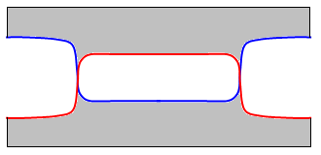
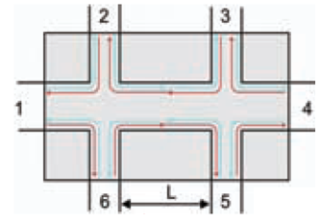
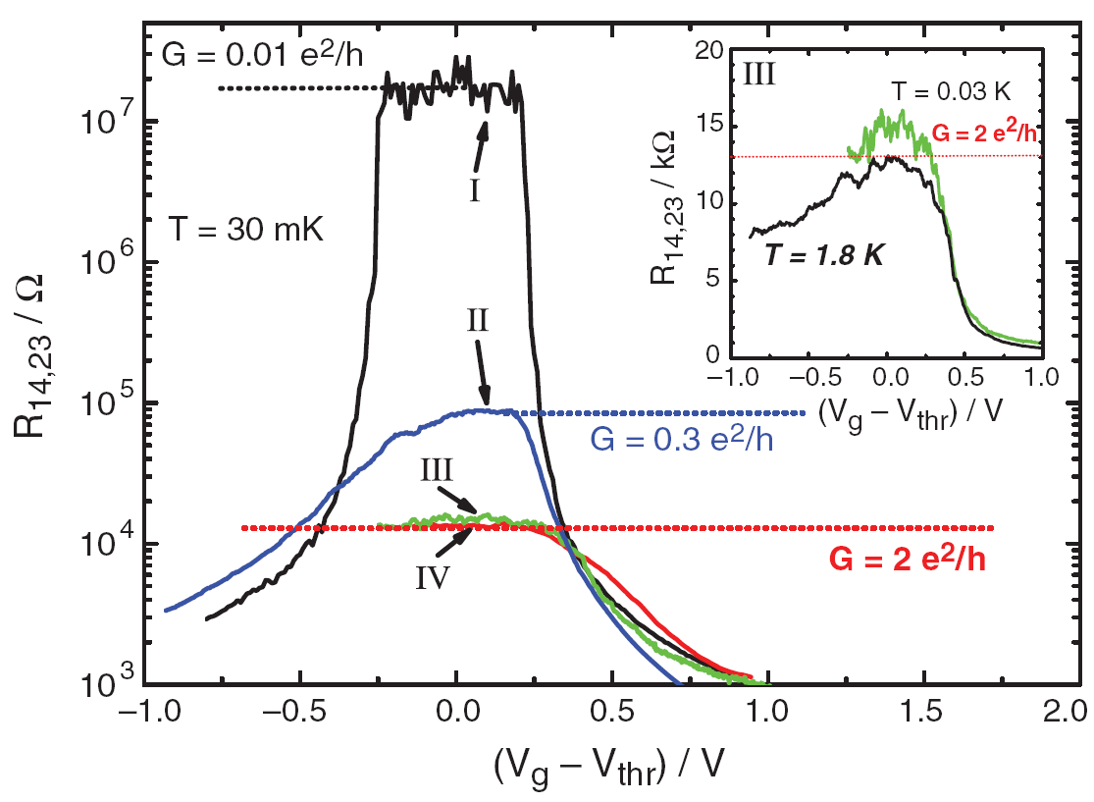
Experimental Observations
Large samples show large resistance at the gap.
Small samples (~1X1μm) show quantized conductance at the gap, indicating transport by edge states.
g: 20-50
 | d (nm) | L×W (μm²)
I | 5.5 | 20.0×13.3
II | 7.3 | 20.0×13.3
III | 7.3 | 1.0×1.0
IV | 7.3 | 1.0×0.5
Molenkamp’s group

Slide 15
Problems with the interpretation:
Why the “quantization” of the conductance takes place only in short samples?
 | d (nm) | L×W (μm²)
I | 5.5 | 20.0×13.3
II | 7.3 | 20.0×13.3
III | 7.3 | 1.0×1.0
IV | 7.3 | 1.0×0.5
NO
NO
YES ?
YES
Molenkamp et al.

Slide 16
Time Reversal Symmetry protects Helical Edge Modes from Backscattering and Anderson Localization
Conductance of an ideal 1D helical edge should be:
In reality, conductance of only extremely small fraction of short samples is somewhat close to , while for most of the short samples and all of the long samples

Slide 17
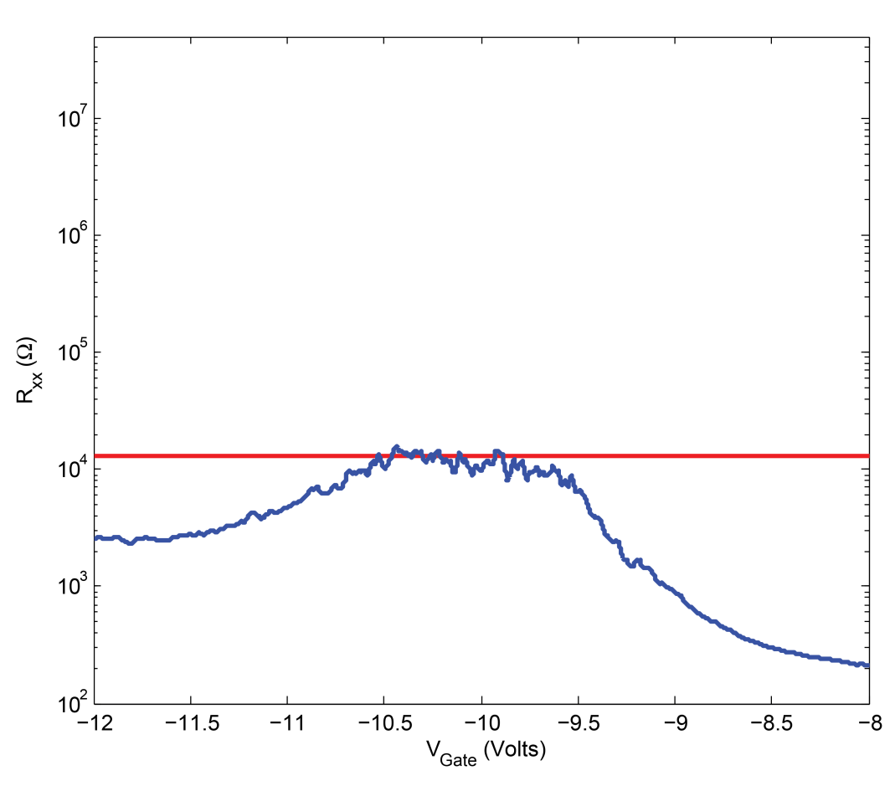
Problems with the interpretation:
Why the “quantization” of the conductance takes place only in short samples?
 | d (nm) | L×W (μm²)
I | 5.5 | 20.0×13.3
II | 7.3 | 20.0×13.3
III | 7.3 | 1.0×1.0
IV | 7.3 | 1.0×0.5
NO
Magic of the log scale
NO
YES
YES

Slide 18
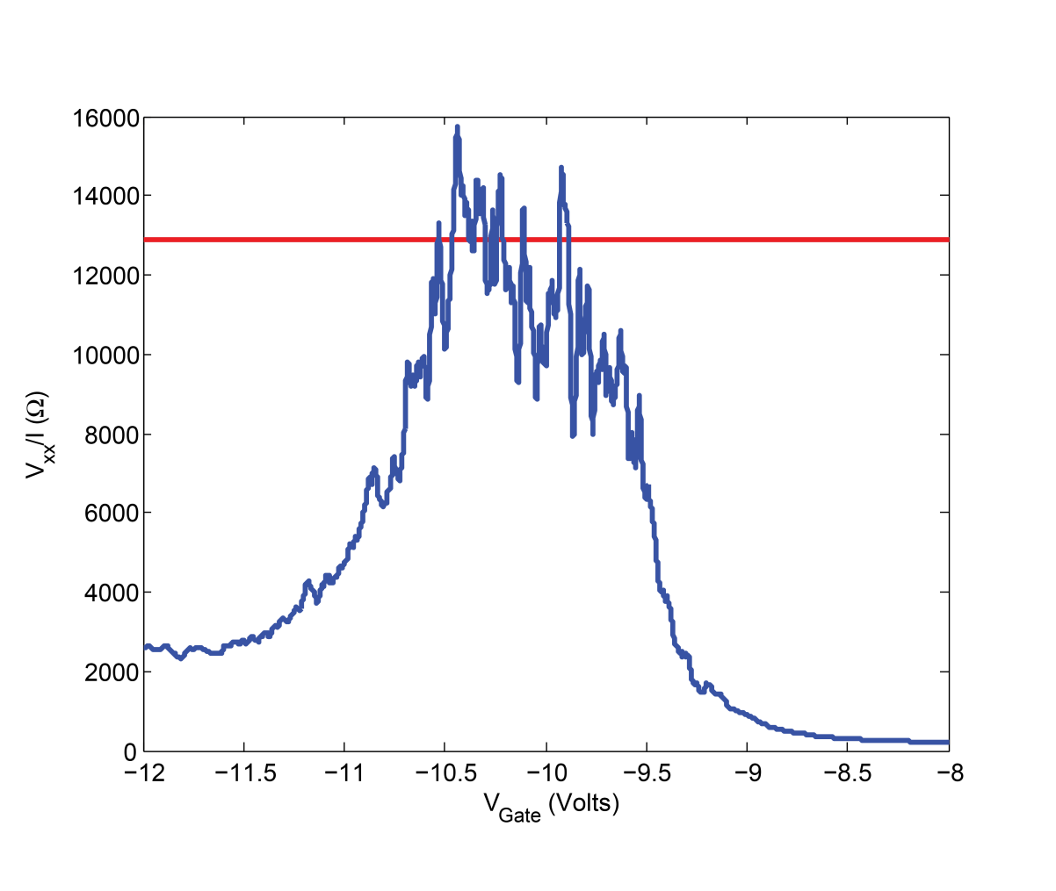
Problems with the interpretation:
Why the “quantization” of the conductance takes place only in short samples?
Why the accuracy of the quantization is so poor? Impressive only in the log scale
Yacoby group
Harvard
Molenkamp group
reproducible
The same sample !

Slide 19
Questions:
How universal is the protection?
Can the “topological protection” be softened?
Can helical edge electrons be localized?
Role of many-body effects?

Slide 20
Time Reversal Symmetry can be trivially broken by an External Magnetic Field
Spatially homogeneous field – no effect!
Modulated field –> energy gap
Homogeneous field + potential disorder = backscattering!
Q:
?
What about intrinsic sources of the Time Reversal Symmetry Violation

Slide 21
Formation of the Kondo Spins
Origin: 1. Chemistry: dangling bonds, etc.
2. Disorder + e-e interaction Localized energy levels close to the edge
In the presence of disorder the “edge” is not single connected.

Slide 22
Formation of the Kondo Spins
No e-e interactions:
Only empty or double occupied localized states
Hubbard repulsion
or
Single occupied states spins

Slide 23
Localized Spins in the presence of itinerant electrons = Kondo Spins
Origin: 1. Chemistry: dangling bonds, etc.
2. Localized energy levels close to the edge
Onsite Hubbard repulsion – Anderson Impurity Model
4 states of each localized level. Different energies
(Anderson, 1961)
E_{c}
E_{c} – energy of the repulsion
E₂-E₁
{
Chemical
potential
E₀ > E₁
E₀-E₁
E=0
E_{c} >m
E₂ > E₁

Slide 24
Anderson Model Kondo Model
or
Interaction between the itinerant electrons and the Kondo Spins

Slide 25
Interaction between the itinerant electrons and the Kondo Spins
or
Kondo Effect – Screening of the localized spins

Slide 26
Magnetic (spin) impurity near the helical edge
single electron impurity
Electron-spin interaction:
electron spin
impurity spin
U(1)-symmetry: symmetry under rotation around z-axis in the spin space = conservation of the z-component of the total spin
No influence on the T = 0 dc charge transport
Reasons:

Slide 27
U(1) - symmetric (xy-isotropic) electron-spin interaction has no influence on T=0 dc transport
Kinematic reason
Maciejko, Liu, Oreg, Qi, Wu, Zhang (2009)
Tanaka, Furusaki, Matveev (2011)
Spin down impurity can back-scatter a right-moving electron.
However, subsequent backscattering of right-moving electrons is impossible until some left-moving electron reverse the impurity spin!
The impurities can effect ac conductivity but not dc one!
Reason: conservation of , i.e. U(1)-symmetry
S_{z}

Slide 28
U(1) - symmetric (xy-isotropic) electron-spin interaction has no influence on zero-temperature dc charge transport
Second reason:
Kondo effect - screening of the impurity spin
Recovery of the Time Reversal Symmetry
Kondo exchange
Does not depend on the U(1)-symmetry

Slide 29
RKKY interaction of localized spins
d – number of dimensions
Finite density of spins – competition between the Kondo effect and RKKY interaction of the spins
S. Doniach (1977)

Slide 30
Single spin: T-invariance always survives due to the Kondo effect
Finite density of spins: T-invariance can be violated spontaneously (Kondo RKKY)
but
the backscattering would not appear as long as z-component of the total spin is conserved = the system remains U(1)-symmetric, i.e. invariant under rotations in spin space around z-axis.
Q:
What if there is a small but finite density of localized and anisotropic spins
?

Slide 31
Q:
What if there is a small but finite density of localized and anisotropic spins
?
Indirect exchange of the localized spins - “RKKY” interaction
density of spins
Kondo
Spin glass
RKKY
electron-spin coupling constant
Broken
T-invariance
T-invariant
Spontaneous breaking of the time-reversal symmetry

Slide 32
 | No magnetic anisotropy U(1) is conserved | Magnetic anisotropy is not conserved U(1)
No disorder (regular spin chain) | Perfect 1D metal | Band Insulator: Charged excitations are gapped even at the edge
Disorder | Goldstone mode perfect 1D metal | Anderson Insulator: Edge states are localized

Slide 33
It is as difficult to preserve U(1) symmetry as to preserve translation invariance

Slide 34
 | No magnetic anisotropy U(1) is conserved | Magnetic anisotropy is not conserved U(1)
No disorder (regular spin chain) | Perfect 1D metal | Band Insulator: Charged excitations are gapped even at the edge
Disorder | Goldstone mode perfect 1D metal | Anderson Insulator: Edge states are localized

Slide 35
Effect of the environment cannot be reduced to an external noise. The most important is the appearance of the additional degrees of freedom. As a result the Hilbert space is increased, which can easily destroy the topology.

Slide 36

Our Model
Helical edge
Insulating bulk
Localized spins
Right mover
Spin up
Left mover
Spin down
Helical edge
$$\sim a$$
z
y
x
Localized spin impurities located at
Linear spin density
Averaged spin density:

Slide 37
Hamiltonian:
Electron operator:
Free helical electrons:

Slide 38
Hamiltonian:
Electron operator:
Free helical electrons:
Electron-spin interaction:
- electron spin ( )
add

Slide 39
Hamiltonian:
Electron operator:
Free helical electrons:
Electron-spin interaction:
- electron spin ( )
add
Note: the Hamiltonian is T-invariant

Slide 40
Electron-spin interaction
Effective spin-spin (“RKKY”) interaction
Helical (chiral) electrons
Usual (non-chiral) electrons

Slide 41
Electron-spin interaction
Effective spin-spin (“RKKY”) interaction
Helical (chiral) electrons
Usual (non-chiral) electrons
Features of chirality:
Can be removed by
1. No interaction
2.Factorization instead of

Slide 42

Helical edge
Insulating bulk
Localized spins
Helical edge
y
z
x
black
red

Slide 43

Ferromagnet (rather than
Spin Glass) without mean magnetization
(Mattis model of spin glass)
Effective spins with ferromagnetic exchange interaction
Helical edge
Insulating bulk
Localized spins
Right mover
Spin up
Left mover
Spin down
Helical edge
$$\sim a$$
z
y
x

Slide 44
Coherent representation of the spins:
is parametrized by and
Wess, Zumino. (1971).
Witten. (1983)

Slide 45
Need to
Integrate over
Integrate over
Take into account the chiral anomaly

Slide 46
Matsubara Action (U(1)-symmetric)
Note: if then the electrons are gapped!
Gauge transformation to account for variations of

Slide 47
Matsubara Action (U(1)-symmetric)
Need to
Integrate over
Integrate over
Take into account the chiral anomaly

Slide 48
Mapping for isotropic exchange
Free chiral edge electrons
Electron-spin exchange
U(1) - symmetry
Effective velocity
Luttinger Liquid
with small velocity
and
small Luttinger parameter
Luttinger parameter
Ideal Metallic Conductance even in the presence of a potential disorder
Bosonic field
Goldstone mode

Slide 49
Mapping for anisotropic exchange
Electron-spin interaction:
Anisotropy of j-th spin
If is independent of j, then the spectrum is gapfull
More likely is random!
Measure of the U(1) breaking disorder
Continuous limit

Slide 50
Matsubara Action (broken U(1)-symmetry)
Electron-spin interaction:
Modified boson action:

Slide 51
Mapping for anisotropic exchange
Mapping on the problem of the pinning of one-dimensional charge-density wave by potential disorder.
(Giamarchi & Schulz, 1988 )
Localization length

Slide 52
If localization length exceeds the system size
something like a quantization of the conductance
Mesoscopic fluctuations are probably caused by the rearrangement of the spins with the change of the gate voltage

Slide 53
Conclusions
Interaction of helical edge electrons with closely located spin (Kondo) impurities lead to Anderson localization of electrons if the total z-component of spin is not conserved (broken U(1) symmetry).
Many-Body Localization !?
Physical interpretation:
In the presence of U(1) symmetry spins rotate in the xy-plane. This restores effectively the time reversal symmetry and prevents localization;
2. If U(1) symmetry is randomly broken, the spins are pinned, which means a spontaneous breaking of T-invariance, i.e. there remains no protection against Anderson localization

Slide 54
Q:
?
Is the topological insulator a distinct new state of matter

Slide 55
Q:
Is the topological insulator a distinct new state of matter or it is a conventional Anderson insulator with the localization length at the edge can substantially exceed the one in the bulk.
?
Note that an arbitrary small concentration of Kondo impurities with arbitrary weak anisotropy eventually destroys the quantization.

Slide 56
To take home:
Albeit electrons at 1d helical edge of a 2D topological insulator are more protected from an influence of random imperfections, they are still subjected to Anderson localization similar to the usual 1D conductors. However the localization can be much bigger than the one in the bulk.
Thank you!

